Slide 1
Lecture 7: RNN- II

Slide 2
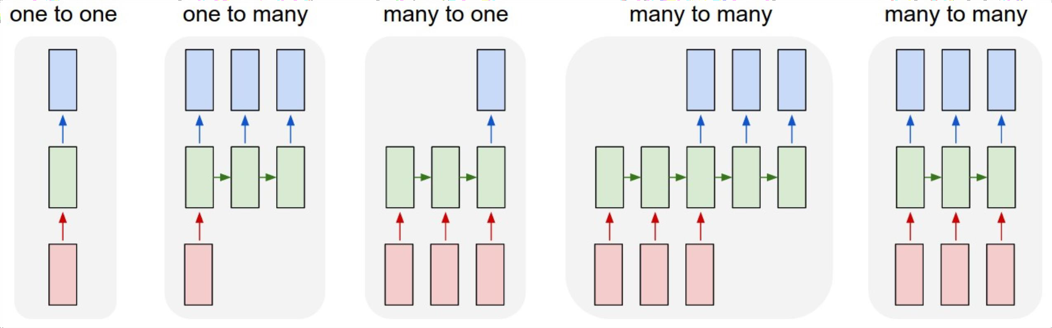
Last Time: Recurrent Neural Networks

Slide 3

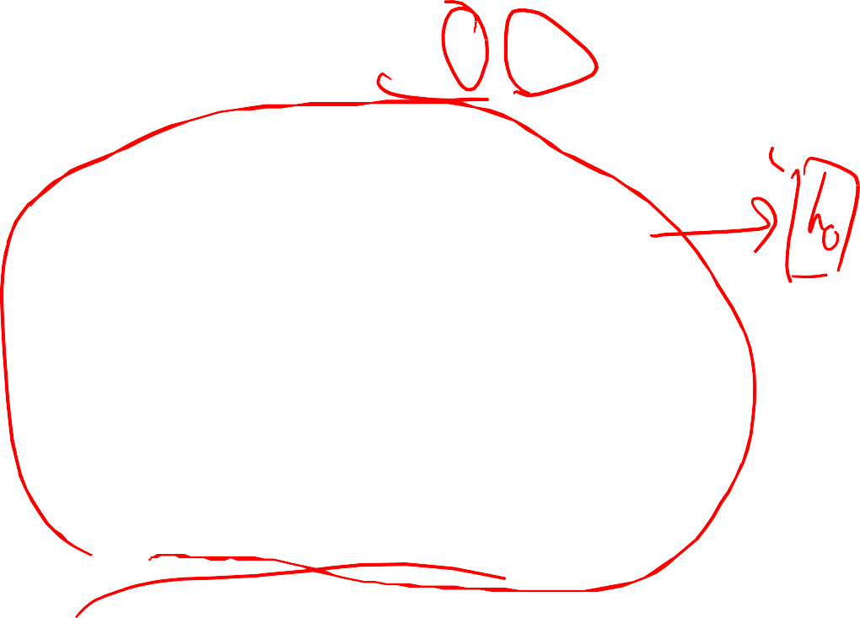
Sequence-to-Sequence with RNNs
Input: Sequence x₁, … x_{T}
Output: Sequence y₁, …, y_{T’}
Encoder: h_{t} = f_{W}(x_{t}, h_{t-1})
h₁
h₂
h₃
h₄
x₁
x₂
x₃
x₄
we
are
eating
bread
Sutskever et al, “Sequence to sequence learning with neural networks”, NeurIPS 2014

Slide 4

Sequence-to-Sequence with RNNs
Input: Sequence x₁, … x_{T}
Output: Sequence y₁, …, y_{T’}
From ﬁnal hidden state predict:
Initial decoder state s₀
Context vector c (often c=h_{T})
Encoder: h_{t} = f_{W}(x_{t}, h_{t-1})
h₁
h₂
h₃
h₄
s₀
x₁
x₂
x₃
x₄
c
we
are
eating
bread
Sutskever et al, “Sequence to sequence learning with neural networks”, NeurIPS 2014

Slide 5
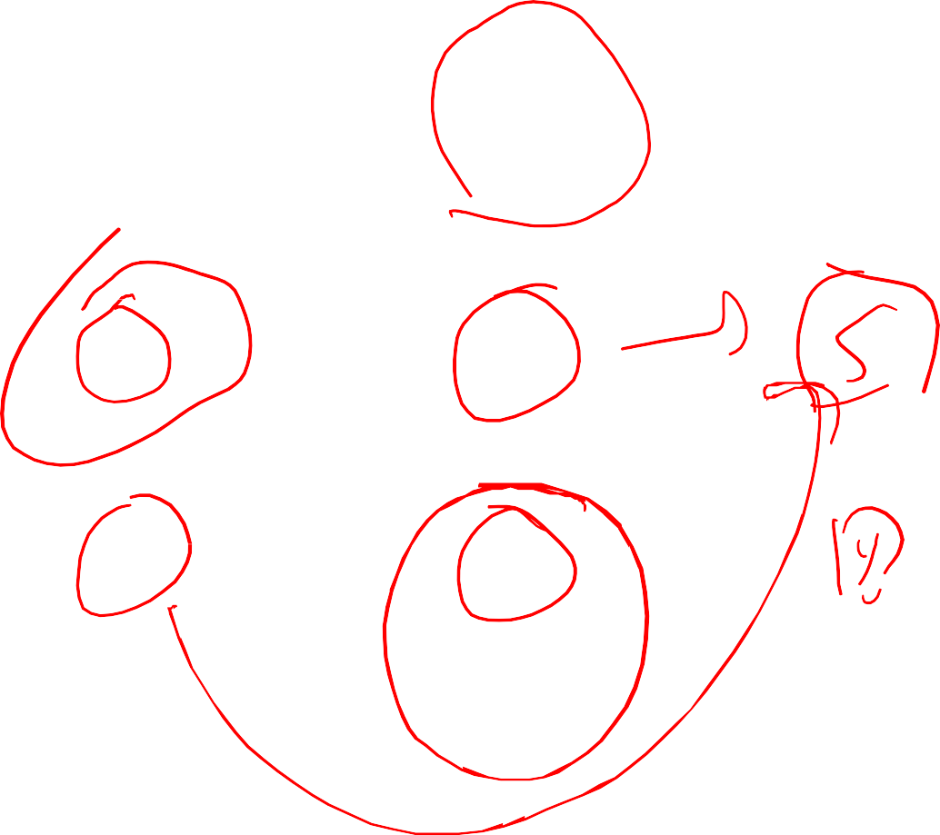
Sequence-to-Sequence with RNNs
Input: Sequence x₁, … x_{T}
Output: Sequence y₁, …, y_{T’}
Decoder: s_{t} = g_{U}(y_{t-1}, h_{t-1}, c)
estamos
From ﬁnal hidden state predict:
Initial decoder state s₀
Context vector c (often c=h_{T})
y₁
Encoder: h_{t} = f_{W}(x_{t}, h_{t-1})
h₁
h₂
h₃
h₄
s₀
s₁
x₁
x₂
x₃
x₄
c
y₀
we
are
eating
bread
[START]
Sutskever et al, “Sequence to sequence learning with neural networks”, NeurIPS 2014

Slide 6

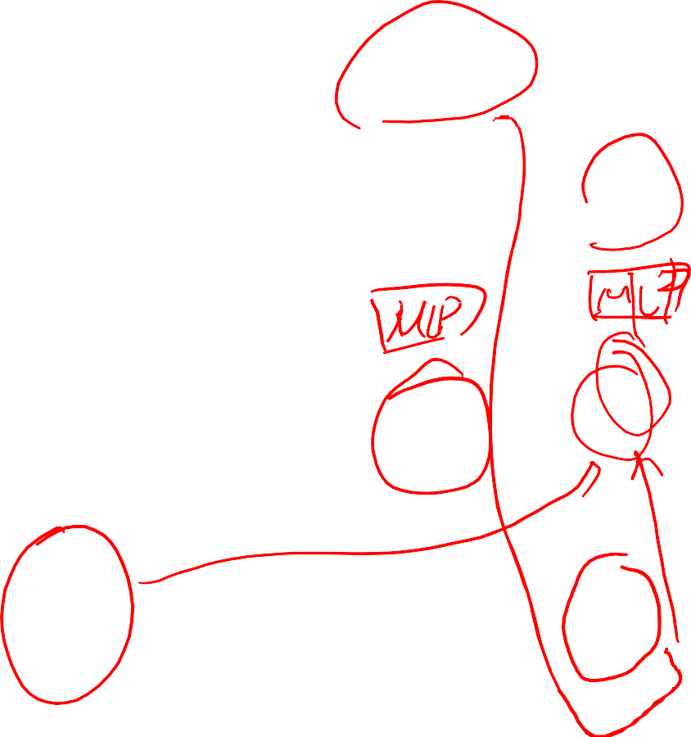
Sequence-to-Sequence with RNNs
Input: Sequence x₁, … x_{T}
Output: Sequence y₁, …, y_{T’}
Decoder: s_{t} = g_{U}(y_{t-1}, h_{t-1}, c)
estamos comiendo
From ﬁnal hidden state predict:
Initial decoder state s₀
Context vector c (often c=h_{T})
y₁
y₂
Encoder: h_{t} = f_{W}(x_{t}, h_{t-1})
h₁
h₂
h₃
h₄
s₀
s₁
s₂
x₁
x₂
x₃
x₄
c
y₀
y₁
we
are
eating
bread
[START]
estamos
Sutskever et al, “Sequence to sequence learning with neural networks”, NeurIPS 2014

Slide 7


Sequence-to-Sequence with RNNs
Input: Sequence x₁, … x_{T}
Output: Sequence y₁, …, y_{T’}
Decoder: s_{t} = g_{U}(y_{t-1}, h_{t-1}, c)
estamos comiendo pan [STOP]
From ﬁnal hidden state predict:
Initial decoder state s₀
Context vector c (often c=h_{T})
y₁
y₂
y₃
y₄
Encoder: h_{t} = f_{W}(x_{t}, h_{t-1})
h₁
h₂
h₃
h₄
s₀
s₁
s₂
s₃
s₄
x₁
x₂
x₃
c
y₀
y₁
y₂
y₃
x₄
we
are
eating
bread
[START]
estamos
comiendo
pan
Sutskever et al, “Sequence to sequence learning with neural networks”, NeurIPS 2014

Slide 8

Sequence-to-Sequence with RNNs
Input: Sequence x₁, … x_{T}
Output: Sequence y₁, …, y_{T’}
Decoder: s_{t} = g_{U}(y_{t-1}, h_{t-1}, c)
estamos comiendo pan [STOP]
From ﬁnal hidden state predict:
Initial decoder state s₀
Context vector c (often c=h_{T})
y₁
y₂
y₃
y₄
Encoder: h_{t} = f_{W}(x_{t}, h_{t-1})
h₁
h₂
h₃
h₄
s₀
s₁
s₂
s₃
s₄
x₁
x₂
x₃
x₄
c
y₀
y₁
y₂
y₃
Problem: Input sequence bottlenecked through ﬁxed- sized vector. What if T=1000?
we
are
eating
bread
[START]
estamos
comiendo
pan
Sutskever et al, “Sequence to sequence learning with neural networks”, NeurIPS 2014

Slide 9

Sequence-to-Sequence with RNNs
Input: Sequence x₁, … x_{T}
Output: Sequence y₁, …, y_{T’}
Decoder: s_{t} = g_{U}(y_{t-1}, h_{t-1}, c)
estamos comiendo pan [STOP]
From ﬁnal hidden state predict:
Initial decoder state s₀
Context vector c (often c=h_{T})
y₁
y₂
y₃
y₄
Encoder: h_{t} = f_{W}(x_{t}, h_{t-1})
h₁
h₂
h₃
h₄
s₀
s₁
s₂
s₃
s₄
x₁
x₂
x₃
x₄
c
y₀
y₁
y₂
y₃
Problem: Input sequence
bottlenecked through
ﬁsixzeedd-vector. What if T=1000?
[START] estamos comiendo
Idea: use new context vector
at each step of decoder!
we
are
eating
bread
pan
Sutskever et al, “Sequence to sequence learning with neural networks”, NeurIPS 2014

Slide 10
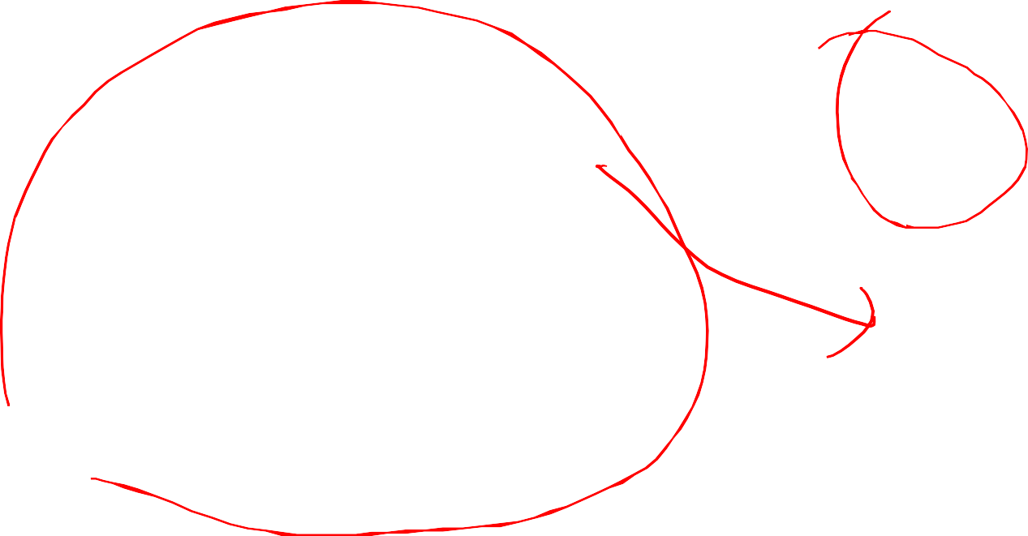
Sequence-to-Sequence with RNNs and attention
Input: Sequence x₁, … x_{T}
Output: Sequence y₁, …, y_{T’}
From ﬁnal hidden state:
Initial decoder state s₀
Encoder: h_{t} = f_{W}(x_{t}, h_{t-1})
h₁
h₂
h₃
h₄
s₀
x₁
x₂
x₃
x₄
we
are
eating
bread
Bahdanau et al, “Neural machine transla$on by jointly learning to align and translate”, ICLR 2015

Slide 11

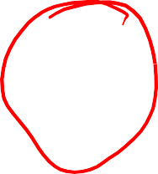
Sequence-to-Sequence with RNNs and attention
Compute (scalar) alignment scores
et,i = fatt(st-1, hi)
(f_{att} is an MLP)
From ﬁnal hidden state:
Ini0al decoder state s₀
e11
e12
e13
e14
h₁
h₂
h₃
h₄
s₀
x₁
x₂
x₃
x₄
we
are
eating
bread
Bahdanau et al, “Neural machine transla$on by jointly learning to align and translate”, ICLR 2015

Slide 12
Sequence-to-Sequence with RNNs and Attention
Compute (scalar) alignment scores
et,i = fatt(st-1, hi)
(f_{att} is an MLP)
a11
a12
a13
a14
Normalize alignment scores
to get attention weights
0 < a_{t,i} < 1 ∑_{i}a_{t,i} = 0
softmax
From ﬁnal hidden state:
Initial decoder state s₀
e11
e12
e13
e14
h₁
h₂
h₃
h₄
s₀
x₁
x₂
x₃
x₄
we
are
eating
bread
Bahdanau et al, “Neural machine transla$on by jointly learning to align and translate”, ICLR 2015

Slide 13

Sequence-to-Sequence with RNNs and Attention
Compute (scalar) alignment scores
a12 ª13
softmax
e12 e13
et,i = fatt(st-1, hi)
(f_{att} is an MLP)
a
11
a14
Normalize alignment scores
to get attention weights
0 < a_{t,i} < 1 ∑_{i}a_{t,i} = 0
Compute context vector as linear
combination of hidden states
ct = ∑iat,ihi
From ﬁnal hidden state:
Ini0al decoder state s₀
e
11
e14
h₁
h₂
h₃
h₄
s₀
+
x₁
x₂
x₃
x₄
c₁
we
are
eating
bread
Bahdanau et al, “Neural machine transla$on by jointly learning to align and translate”, ICLR 2015

Slide 14
Sequence-to-Sequence with RNNs and Attention
Compute (scalar) alignment scores
et,i = fatt(st-1, hi)
(f_{att} is an MLP)
a
a
a
13
a
14
11
12
estamos
Normalize alignment scores
to get Attention weights
0 < a_{t,i} < 1 ∑_{i}a_{t,i} = 0
Compute context vector as linear
combina$on of hidden states
ct = ∑iat,ihi
softmax
From ﬁnal hidden state:
Ini0al decoder state s₀
y₁
e11
e
12
e
13
e14
h₁
h₂
h₃
h₄
s₀
+
s₁
Use context vector in
decoder: s_{t} = g_{U}(y_{t-1}, s_{t-1}, c_{t})
x₁
x₂
x₃
x₄
c₁
y₀
we
are
eating
bread
This is all diﬀerentiable! Do not supervise attention weights – backprop through everything
Bahdanau et al, “Neural machine transla$on by jointly learning to align and translate”, ICLR 2015

Slide 15
Sequence-to-Sequence with RNNs and Attention
Compute (scalar) alignment scores
et,i = fatt(st-1, hi)
(f_{att} is an MLP)
a
a
a
13
a
14
11
12
estamos
Normalize alignment scores
to get Attention weights
0 < a_{t,i} < 1 ∑_{i}a_{t,i} = 0
Compute context vector as linear
combination of hidden states
ct = ∑iat,ihi
softmax
From ﬁnal hidden state:
Ini0al decoder state s₀
y₁
e11
e
12
e
13
e14
h₁
h₂
h₃
h₄
s₀
+
s₁
Intui0on: Context vector attends to the relevant part of the input sequence “estamos” = “we are”
so maybe a₁₁=a₁₂=0.45,
a₁₃=a₁₄=0.05
Use context vector in
decoder: s_{t} = g_{U}(y_{t-1}, s_{t-1}, c_{t})
x₁
x₂
x₃
x₄
c₁
y₀
we
are
eating
bread
This is all diﬀerentiable! Do not supervise attention weights – backprop through everything
Bahdanau et al, “Neural machine transla$on by jointly learning to align and translate”, ICLR 2015

Slide 16
Sequence-to-Sequence with RNNs
Repeat: Use s₁ to compute new context vector c₂
a22 ª23
softmax
e22 e23
a21
a24
estamos
y₁
e21
e24
+
h₁
h₂
h₃
h₄
s₀
s₁
x₁
x₂
x₃
x₄
c₁
y₀
c₂
we
are
eating
bread
[START]
Bahdanau et al, “Neural machine transla$on by jointly learning to align and translate”, ICLR 2015

Slide 17
Sequence-to-Sequence with RNNs and Attention
a22 ª23
softmax
^{e}22 ^{e}23
a21
a24
comiendo
estamos
y₁
y₂
Repeat: Use s₁ to compute new context vector c
^{e}21
^{e}24
+
2
Use c₂ to compute s₂, y₂
h₁
h₂
h₃
h₄
s₀
s₁
s₂
x₁
x₂
x₃
x₄
c₁
y₀
c₂
y₁
we
are
eating
bread
[START]
estamos
Bahdanau et al, “Neural machine transla$on by jointly learning to align and translate”, ICLR 2015

Slide 18
Sequence-to-Sequence with RNNs and Attention
a22 ª23
softmax
^{e}22 ^{e}23
a21
a24
comiendo
estamos
y₁
y₂
Repeat: Use s₁ to compute new context vector c
^{e}21
^{e}24
+
2
Use c₂ to compute s₂, y₂
h₁
h₂
h₃
h₄
s₀
s₁
s₂
Intui0on: Context vector attends to the relevant part of the input sequence “comiendo” = “eating”
so maybe a₂₁=a₂₄=0.05, a₂₂=0.1, a₂₃=0.8
x₁
x₂
x₃
x₄
c₁
y₀
c₂
y₁
we
are
eating
bread
[START]
estamos
Bahdanau et al, “Neural machine transla$on by jointly learning to align and translate”, ICLR 2015

Slide 19
Sequence-to-Sequence with RNNs and Attention
Use a diﬀerent context vector in each timestep of decoder
Input sequence not bottlenecked through single vector
At each timestep of decoder, context vector “looks at”
diﬀerent parts of the input sequence
estamos comiendo
pan
[STOP]
y₁
y₂
y₃
y₄
h₁
h₂
h₃
h₄
s₀
s₁
s₂
s₃
s₄
x₁
x₂
x₃
x₄
c₁
y₀
c₂
y₁
c₃
y₂
c₄
y₃
we
are
eating
bread
[START]
estamos
comiendo
pan
Bahdanau et al, “Neural machine transla$on by jointly learning to align and translate”, ICLR 2015

Slide 20
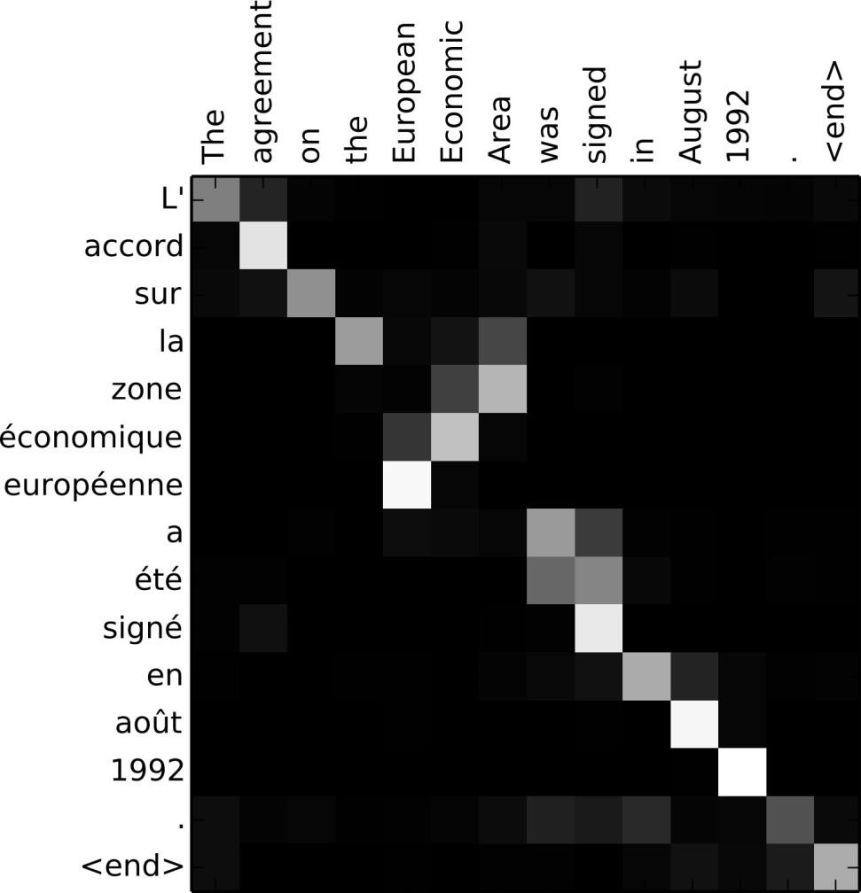
Sequence-to-Sequence with RNNs and Attention
Visualize attition weights a_{t,i}
Example: English to French translation
Input: “The agreement on the European Economic Area was signed in August 1992.”
Output: “L’accord sur la zone économique européenne a été signé en août 1992.”
Bahdanau et al, “Neural machine transla$on by jointly learning to align and translate”, ICLR 2015

Slide 21
Sequence-to-Sequence with RNNs and
A, en. on
Example: English to French transla$on
Visualize attention weights
at,i
Input: “The agreement on the European Economic Area was signed in August 1992.”
Diagonal Attention means
words correspond in order
Output: “L’accord sur la zone économique européenne a été signé en août 1992.”
Diagonal Attention means words correspond in order
Bahdanau et al, “Neural machine transla$on by jointly learning to align and translate”, ICLR 2015

Slide 22
Sequence-to-Sequence with RNNs and
A, en. on
Example: English to French transla$on
Visualize attention weights
at,i
Input: “The agreement on the European Economic Area was signed in August 1992.”
Diagonal Attention means
words correspond in order
Attention ﬁgures out
diﬀerent word orders
Output: “L’accord sur la zone économique européenne a été signé en août 1992.”
Diagonal Attention means words correspond in order
Bahdanau et al, “Neural machine transla$on by jointly learning to align and translate”, ICLR 2015

Slide 23
Sequence-to-Sequence with RNNs and ^{Attention}The decoder doesn’t use the fact that
h_{i} form an ordered sequence – it just
treats them as an unordered set {h_{i}}
estamos comiendo
pan
[STOP]
Can use similar architecture given any set of input hidden vectors {h_{i}}!
y₁
y₂
y₃
y₄
h₁
h₂
h₃
h₄
s₀
s₁
s₂
s₃
s₄
x₁
x₂
x₃
x₄
c₁
y₀
c₂
y₁
c₃
y₂
c₄
y₃
we
are
eating
bread
[START]
estamos
comiendo
pan
Bahdanau et al, “Neural machine transla$on by jointly learning to align and translate”, ICLR 2015

Slide 24
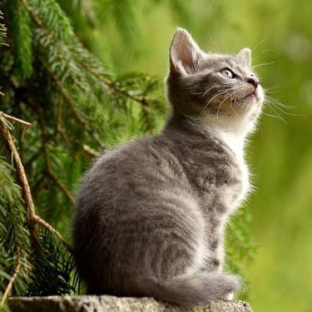
Image Cap.oning with RNNs and Attention
h1,1 | h1,2 | h1,3
h2,1 | h2,2 | h2,3
h3,1 | h3,2 | h3,3
CNN
s₀
Use a CNN to compute a grid of features for an image
Cat image is free to use under the Pixabay License
Xu et al, “Show, attend, and Tell: Neural Image Cap$on Genera$on with Visual Attention”, ICML 2015

Slide 25
Image Captioning with RNNs and Attention
Alignment scores
et,i,j = fatt(st-1, hi,j)
e1,1,1 | e1,1,2 | e1,1,3
e1,2,1 | e1,2,2 | e1,2,3
e1,3,1 | e1,3,2 | e1,3,3
h1,1 | h1,2 | h1,3
h2,1 | h2,2 | h2,3
h3,1 | h3,2 | h3,3
CNN
s₀
Use a CNN to compute a grid of features for an image
Xu et al, “Show, attend, and Tell: Neural Image Cap$on Genera$on with Visual Attention”, ICML 2015

Slide 26
Image Captioning with RNNs and Attention
Alignment scores AEention weights
et,i,j = f^{att}(st-1, hi,j) a_{t,:,:} = softmax(e_{t,:,:})
e1,1,1 | e1,1,2 | e1,1,3
e1,2,1 | e1,2,2 | e1,2,3
e1,3,1 | e1,3,2 | e1,3,3
a1,1,1 | a1,1,2 | a1,1,3
a1,2,1 | a1,2,2 | a1,2,3
a1,3,1 | a1,3,2 | a1,3,3
softmax
h1,1 | h1,2 | h1,3
h2,1 | h2,2 | h2,3
h3,1 | h3,2 | h3,3
CNN
s₀
Use a CNN to compute a grid of features for an image
Xu et al, “Show, attend, and Tell: Neural Image Cap$on Genera$on with Visual Attention”, ICML 2015

Slide 27

Image Captioning with RNNs and Attention
Alignment scores Attention weights
et,i,j = fatt(st-1, hi,j) a_{t,:,:} = softmax(e_{t,:,:})
ct = ∑i,jat,i,jhi,j
e1,1,1 | e1,1,2 | e1,1,3
e1,2,1 | e1,2,2 | e1,2,3
e1,3,1 | e1,3,2 | e1,3,3
a1,1,1 | a1,1,2 | a1,1,3
a1,2,1 | a1,2,2 | a1,2,3
a1,3,1 | a1,3,2 | a1,3,3
softmax
h1,1 | h1,2 | h1,3
h2,1 | h2,2 | h2,3
h3,1 | h3,2 | h3,3
CNN
s₀
c₁
Use a CNN to compute a grid of features for an image
Xu et al, “Show, attend, and Tell: Neural Image Cap$on Genera$on with Visual Attention”, ICML 2015

Slide 28
Image Captioning with RNNs and Attention
Alignment scores attention weights
et,i,j = fatt(st-1, hi,j) a_{t,:,:} = softmax(e_{t,:,:})
ct = ∑i,jat,i,jhi,j
e1,1,1 | e1,1,2 | e1,1,3
e1,2,1 | e1,2,2 | e1,2,3
e1,3,1 | e1,3,2 | e1,3,3
a1,1,1 | a1,1,2 | a1,1,3
a1,2,1 | a1,2,2 | a1,2,3
a1,3,1 | a1,3,2 | a1,3,3
softmax
cat
y₁
h1,1 | h1,2 | h1,3
h2,1 | h2,2 | h2,3
h3,1 | h3,2 | h3,3
CNN
s₀
s₁
c₁
y₀
Use a CNN to compute a grid of features for an image
[START]
Xu et al, “Show, attend, and Tell: Neural Image Cap$on Genera$on with Visual Attention”, ICML 2015

Slide 29
Image Captioning with RNNs and Attention
Alignment scores
et,i,j = fatt(st-1, hi,j) a_{t,:,:} = softmax(e_{t,:,:})
ct = ∑i,jat,i,jhi,j
e2,1,1 | e2,1,2 | e2,1,3
e2,2,1 | e2,2,2 | e2,2,3
e2,3,1 | e2,3,2 | e2,3,3
cat
y₁
h1,1 | h1,2 | h1,3
h2,1 | h2,2 | h2,3
h3,1 | h3,2 | h3,3
CNN
s₀
s₁
c₁
y₀
Use a CNN to compute a grid of features for an image
[START]
Xu et al, “Show, attend, and Tell: Neural Image Cap$on Genera$on with Visual Attention”, ICML 2015

Slide 30
Image Captioning with RNNs and Attention
Alignment scores Attention weights
et,i,j = fatt(st-1, hi,j) a_{t,:,:} = softmax(e_{t,:,:})
ct = ∑i,jat,i,jhi,j
e2,1,1 | e2,1,2 | e2,1,3
e2,2,1 | e2,2,2 | e2,2,3
e2,3,1 | e2,3,2 | e2,3,3
a2,1,1 | a2,1,2 | a2,1,3
a2,2,1 | a2,2,2 | a2,2,3
a2,3,1 | a2,3,2 | a2,3,3
softmax
cat
y₁
h1,1 | h1,2 | h1,3
h2,1 | h2,2 | h2,3
h3,1 | h3,2 | h3,3
CNN
s₀
s₁
c₁
y₀
c₂
Use a CNN to compute a grid of features for an image
[START]
Xu et al, “Show, attend, and Tell: Neural Image Cap$on Genera$on with Visual Attention”, ICML 2015

Slide 31
Image Captioning with RNNs and Attention
Alignment scores Attention weights
et,i,j = fatt(st-1, hi,j) a_{t,:,:} = softmax(e_{t,:,:})
ct = ∑i,jat,i,jhi,j
e2,1,1 | e2,1,2 | e2,1,3
e2,2,1 | e2,2,2 | e2,2,3
e2,3,1 | e2,3,2 | e2,3,3
a2,1,1 | a2,1,2 | a2,1,3
a2,2,1 | a2,2,2 | a2,2,3
a2,3,1 | a2,3,2 | a2,3,3
softmax
cat
sivng
y₁
y₂
h1,1 | h1,2 | h1,3
h2,1 | h2,2 | h2,3
h3,1 | h3,2 | h3,3
CNN
s₀
s₁
s₂
c₁
y₀
c₂
y₁
Use a CNN to compute a grid of features for an image
[START]
cat
Xu et al, “Show, attend, and Tell: Neural Image Cap$on Genera$on with Visual Attention”, ICML 2015

Slide 32
Image Captioning with RNNs and Attention
Each timestep of decoder
e = f
(s , h )
t,i,j att t-1 i,j
uses a diﬀerent context vector that looks at diﬀerent parts of the input image
a_{t,:,:} = softmax(e_{t,:,:}) ct = ∑i,jat,i,jhi,j
cat sivng outside
[STOP]
y₁
y₂
y₃
y₄
h1,1 | h1,2 | h1,3
h2,1 | h2,2 | h2,3
h3,1 | h3,2 | h3,3
CNN
s₀
s₁
s₂
s₃
s₄
c₁
y₀
c₂
y₁
c₃
y₂
c₄
y₃
Use a CNN to compute a grid of features for an image
[START]
cat
sitting
outside
Xu et al, “Show, attend, and Tell: Neural Image Cap$on Genera$on with Visual Attention”, ICML 2015

Slide 33
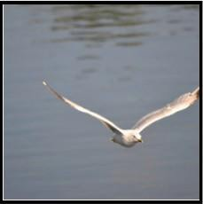
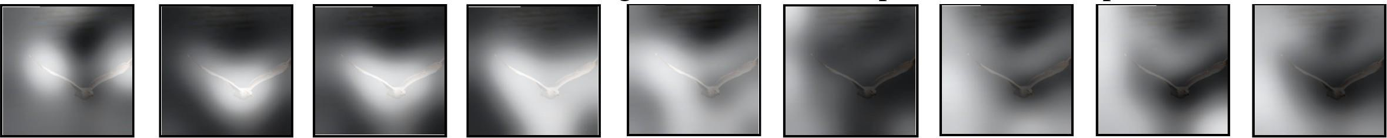
Image Captioning with RNNs and Attention
Xu et al, “Show, attend, and Tell: Neural Image Cap$on Genera$on with Visual Attention”, ICML 2015

Slide 34
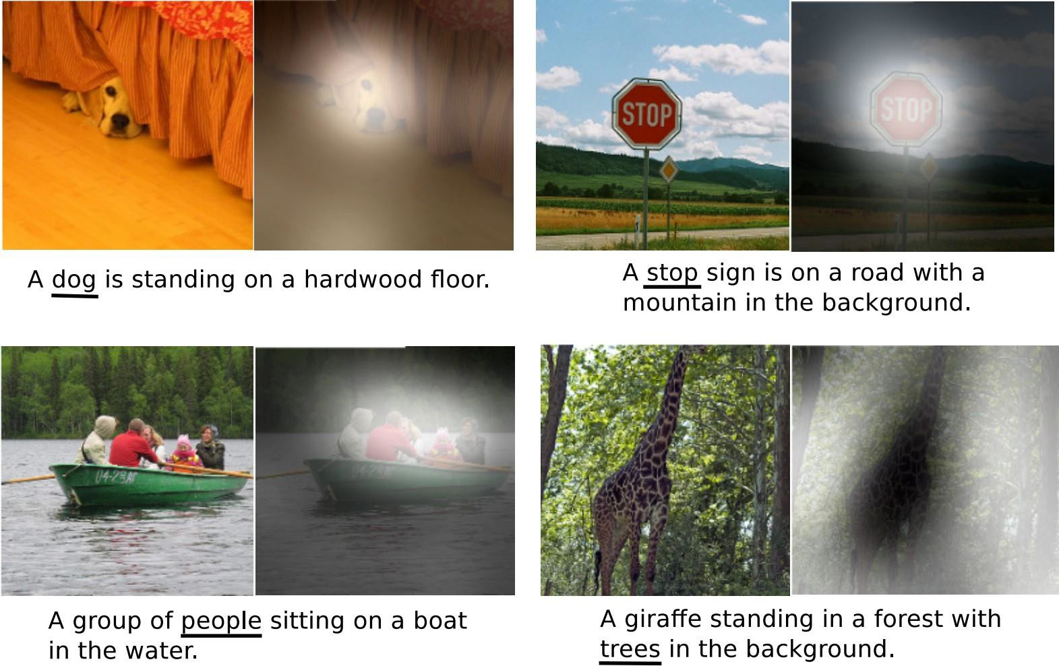
Image Captioning with RNNs and Attention
Xu et al, “Show, attend, and Tell: Neural Image Cap$on Genera$on with Visual Attention”, ICML 2015

Slide 35
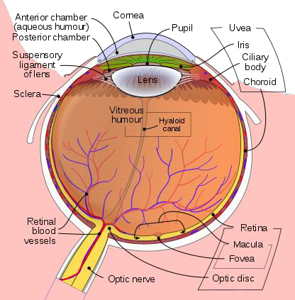

Human Vision: Fovea
Light enters eye
Re0na
detects light
Acuity graph is licensed under CC A-SA 3.0 Unported

Slide 36
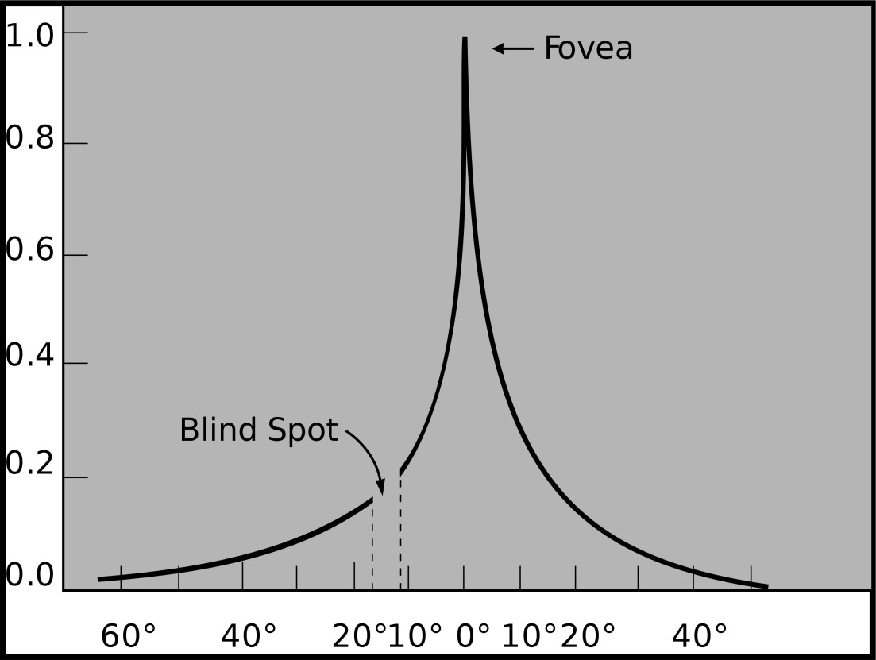

Human Vision:
Fovea
The fovea is a $ny region of the re$na that can see with high acuity
Light enters eye
Re0na
detects light
Eye image is licensed under CC A-SA 3.0 Unported (added black arrow, green arc, and white circle)
Acuity graph is licensed under CC A-SA 3.0 Unported (No changes made)

Slide 37
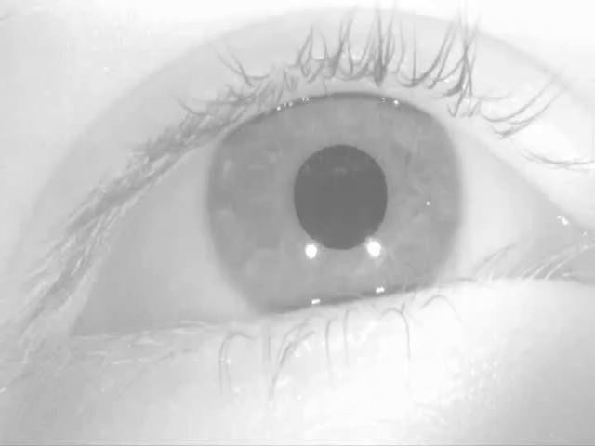
Human Vision:
Saccades
Human eyes are constantly moving so we don’t notice
The fovea is a tiny region of the re$na that can see with high acuity
Saccade video is licensed under CC A-SA 4.0 Interna$onal (no changes made)
Acuity graph is licensed under CC A-SA 3.0 Unported (No changes made)
Lecture 13 - 42

Slide 38
Image Captioning with RNNs and Attention
Attention weights at each timestep kind of like saccades of human eye
Xu et al, “Show, Attend, and Tell: Neural Image Caption Generation with Visual Attention”, ICML
2015
Saccade video is licensed under CC A-SA 4.0 Interna$onal (no changes made)

Slide 39
X, Attend, and Y
“Show, attend, and tell” (Xu et al, ICML 2015)
Look at image, attend to image regions, produce question
“Ask, attend, and answer” (Xu and Saenko, ECCV 2016)
“Show, ask, attend, and answer” (Kazemi and Elqursh, 2017)
Read text of question, attend to image regions, produce answer
“Listen, attend, and spell” (Chan et al, ICASSP 2016)
Process raw audio, attend to audio regions while producing text
“Listen, attend, and walk” (Mei et al, AAAI 2016)
Process text, attend to text regions, output navigation commands
“Show, attend, and interact” (Qureshi et al, ICRA 2017)
Process image, attend to image regions, output robot control commands
“Show, attend, and read” (Li et al, AAAI 2019)
Process image, attend to image regions, output text

Slide 40


Attention Layer
Alignment scores
Attention weights
^{e}t,i,j ^{= f}att^{(s}t-1^{, h}i,j⁾
a_{t,:,:} = softmax(e_{t,:,:})
^{c}t ^{= ∑}i,jªt,i,j^{h}i,j
e2,1,1 | e2,1,2 | e2,1,3
e2,2,1 | e2,2,2 | e2,2,3
e2,3,1 | e2,3,2 | e2,3,3
a2,1,1 | a2,1,2 | a2,1,3
a2,2,1 | a2,2,2 | a2,2,3
a2,3,1 | a2,3,2 | a2,3,3
softmax
seagull
Inputs:
Query vector: q (Shape: D_{Q})
Input vectors: X (Shape: N_{X} x D_{X})
y₁
h1,1
h1,2
h1,3
Similarity function: f
CNN
h2,1
h2,2
h2,3
s₀
s₁
att
h3,1
h3,2
h3,3
c₁
y₀
c₂
[START]
Computation:
Similarities: e (Shape: N_{X}) e_{i} = f_{att}(q, X_{i}) Attention weights: a = softmax(e) (Shape: N_{X})
Output vector: y = ∑_{i}a_{i}X_{i}
(Shape: D_{X})

Slide 41
Attention Layer
Alignment scores
Attention weights
^{e}t,i,j ^{= f}att^{(s}t-1^{, h}i,j⁾
a_{t,:,:} = softmax(e_{t,:,:})
^{c}t ^{= ∑}i,jªt,i,j^{h}i,j
e2,1,1 | e2,1,2 | e2,1,3
e2,2,1 | e2,2,2 | e2,2,3
e2,3,1 | e2,3,2 | e2,3,3
a2,1,1 | a2,1,2 | a2,1,3
a2,2,1 | a2,2,2 | a2,2,3
a2,3,1 | a2,3,2 | a2,3,3
softmax
seagull
Inputs:
Query vector: q (Shape: D_{Q})
Input vectors: X (Shape: N_{X} x D_{Q})
y₁
h1,1
h1,2
h1,3
Similarity function:
CNN
h2,1
h2,2
h2,3
s₀
s₁
dot product
h3,1
h3,2
h3,3
c₁
y₀
c₂
[START]
Computation:
Similarities: e (Shape: N_{X})
e_{i} = q · X_{i}
Changes:
- Use dot product for similarity
Attention weights: a = softmax(e) (Shape: N_{X})
Output vector: y = ∑_{i}a_{i}X_{i}
(Shape: D_{X})

Slide 42
Attention Layer
Alignment scores
Attention weights
^{e}t,i,j ^{= f}att^{(s}t-1^{, h}i,j⁾
a_{t,:,:} = softmax(e_{t,:,:})
^{c}t ^{= ∑}i,jªt,i,j^{h}i,j
e2,1,1 | e2,1,2 | e2,1,3
e2,2,1 | e2,2,2 | e2,2,3
e2,3,1 | e2,3,2 | e2,3,3
a2,1,1 | a2,1,2 | a2,1,3
a2,2,1 | a2,2,2 | a2,2,3
a2,3,1 | a2,3,2 | a2,3,3
softmax
seagull
Inputs:
Query vector: q (Shape: D_{Q})
Input vectors: X (Shape: N_{X} x D_{Q})
y₁
h1,1
h1,2
h1,3
Similarity function:
CNN
h2,1
h2,2
h2,3
s₀
s₁
scaled dot product
h3,1
h3,2
h3,3
c₁
y₀
c₂
[START]
Computation:
Similarities: e (Shape: N_{X})
e_{i} = q · X_{i}
/ sqrt(D_{Q})
Changes:
Attention weights: a = softmax(e) (Shape: N_{X})
-
Use scaled dot product for similarity
Output vector: y = ∑_{i}a_{i}X_{i}
(Shape: D_{X})

Slide 43
Attention Layer
Alignment scores
Attention weights
^{e}t,i,j ^{= f}att^{(s}t-1^{, h}i,j⁾
a_{t,:,:} = softmax(e_{t,:,:})
^{c}t ^{= ∑}i,jªt,i,j^{h}i,j
e2,1,1 | e2,1,2 | e2,1,3
e2,2,1 | e2,2,2 | e2,2,3
e2,3,1 | e2,3,2 | e2,3,3
a2,1,1 | a2,1,2 | a2,1,3
a2,2,1 | a2,2,2 | a2,2,3
a2,3,1 | a2,3,2 | a2,3,3
softmax
seagull
Inputs:
Query vector: q (Shape: D_{Q})
Input vectors: X (Shape: N_{X} x D_{Q})
y₁
h1,1
h1,2
h1,3
Similarity function:
CNN
h2,1
h2,2
h2,3
s₀
s₁
scaled dot product
Large similarities will cause softmax to saturate and give vanishing gradients Recall a · b = |a||b| cos(angle)
Suppose that a and b are constant vectors of
dimension D
Then |a| = (∑_{i}a²)^{1/2} = a sqrt(D)
h3,1
h3,2
h3,3
c₁
y₀
c₂
[START]
Computation:
Similarities: e (Shape: N_{X}) e_{i} = q · X_{i}
/ sqrt(D_{Q})
Changes:
- Use scaled dot product for similarity
Attention weights: a = softmax(e) (Shape: N_{X})
Output vector: y = ∑_{i}a_{i}X_{i} (Shape: D_{X})

Slide 44
Attention Layer
Alignment scores
Attention weights
^{e}t,i,j ^{= f}att^{(s}t-1^{, h}i,j⁾
a_{t,:,:} = softmax(e_{t,:,:})
^{c}t ^{= ∑}i,jªt,i,j^{h}i,j
e2,1,1 | e2,1,2 | e2,1,3
e2,2,1 | e2,2,2 | e2,2,3
e2,3,1 | e2,3,2 | e2,3,3
a2,1,1 | a2,1,2 | a2,1,3
a2,2,1 | a2,2,2 | a2,2,3
a2,3,1 | a2,3,2 | a2,3,3
softmax
seagull
Inputs:
Query vectors:
y₁
Q (Shape: N_{Q} x D_{Q})
h1,1
h1,2
Input vectors: X (Shape: N_{X} x D_{Q})
h1,3
CNN
h2,1
h2,2
h2,3
s₀
s₁
h3,1
h3,2
h3,3
c₁
y₀
c₂
[START]
Computation:
Similarities: E = QX^{T} (Shape: N_{Q} x N_{X}) E_{i,j} = Q_{i} · X_{j} / sqrt(D_{Q}) Attention weights: A = softmax(E, dim=1) (Shape: N_{Q} x N_{X}) Output vectors: Y = AX (Shape: N_{Q} x D_{X}) Y_{i} = ∑_{j}A_{i,j}X_{j}
Changes:
Use dot product for similarity
Multiple query vectors

Slide 45
Attention Layer
Alignment scores
Attention weights
^{e}t,i,j ^{= f}att^{(s}t-1^{, h}i,j⁾
e2,1,1 | e2,1,2 | e2,1,3
e2,2,1 | e2,2,2 | e2,2,3
e2,3,1 | e2,3,2 | e2,3,3
a2,1,1 | a2,1,2 | a2,1,3
a2,2,1 | a2,2,2 | a2,2,3
a2,3,1 | a2,3,2 | a2,3,3
a = softmax(e )
softmax
seagull
t,:,: t,:,:
^{c}t ^{= ∑}i,jªt,i,j^{h}i,j
Inputs:
Query vectors: Q (Shape: N_{Q} x D_{Q})
Input vectors: X (Shape: N_{X} x D_{X})
y₁
h1,1
h1,2
h1,3
CNN
h2,1
h2,2
h2,3
s₀
s₁
Key matrix: W_{K} (Shape: D_{X} x D_{Q})
Value matrix: W_{V} (Shape: D_{X} x D_{V})
h3,1
h3,2
h3,3
c₁
y₀
c₂
[START]
Computation:
Key vectors: K = XW_{K} (Shape: N_{X} x D_{Q})
Value Vectors: V = XW_{V} (Shape: N_{X} x D_{V})
Similarities: E = QK^{T} (Shape: N_{Q} x N_{X}) E_{i,j} = Q_{i} · K_{j} / sqrt(D_{Q}) Attention weights: A = softmax(E, dim=1) (Shape: N_{Q} x N_{X}) Output vectors: Y = AV (Shape: N_{Q} x D_{V}) Y_{i} = ∑_{j}A_{i,j}V_{j}
Changes:
Use dot product for similarity
Multiple query vectors
Separate key and value

Slide 46
Attention Layer
Inputs:
Query vectors: Q (Shape: N_{Q} x D_{Q}) Input vectors: X (Shape: N_{X} x D_{X}) Key matrix: W_{K} (Shape: D_{X} x D_{Q}) Value matrix: W_{V} (Shape: D_{X} x D_{V})
Computation:
Key vectors: K = XW_{K} (Shape: N_{X} x D_{Q})
Value Vectors: V = XW_{V} (Shape: N_{X} x D_{V})
Similarities: E = QK^{T} (Shape: N_{Q} x N_{X}) E_{i,j} = Q_{i} · K_{j} / sqrt(D_{Q}) Attention weights: A = softmax(E, dim=1) (Shape: N_{Q} x N_{X}) Output vectors: Y = AV (Shape: N_{Q} x D_{V}) Y_{i} = ∑_{j}A_{i,j}V_{j}
X₁
X₂
X₃
Q₁
Q₂
Q₃
Q₄

Slide 47
Attention Layer
Inputs:
Query vectors: Q (Shape: N_{Q} x D_{Q}) Input vectors: X (Shape: N_{X} x D_{X}) Key matrix: W_{K} (Shape: D_{X} x D_{Q}) Value matrix: W_{V} (Shape: D_{X} x D_{V})
Computation:
Key vectors: K = XW_{K} (Shape: N_{X} x D_{Q})
Value Vectors: V = XW_{V} (Shape: N_{X} x D_{V})
Similarities: E = QK^{T} (Shape: N_{Q} x N_{X}) E_{i,j} = Q_{i} · K_{j} / sqrt(D_{Q}) Attention weights: A = softmax(E, dim=1) (Shape: N_{Q} x N_{X}) Output vectors: Y = AV (Shape: N_{Q} x D_{V}) Y_{i} = ∑_{j}A_{i,j}V_{j}
X₁
K₁
X₂
K₂
X₃
K₃
Q₁
Q₂
Q₃
Q₄

Slide 48
Attention Layer
Inputs:
Query vectors: Q (Shape: N_{Q} x D_{Q}) Input vectors: X (Shape: N_{X} x D_{X}) Key matrix: W_{K} (Shape: D_{X} x D_{Q}) Value matrix: W_{V} (Shape: D_{X} x D_{V})
Computation:
Key vectors: K = XW_{K} (Shape: N_{X} x D_{Q})
Value Vectors: V = XW_{V} (Shape: N_{X} x D_{V})
Similarities: E = QK^{T} (Shape: N_{Q} x N_{X}) E_{i,j} = Q_{i} · K_{j} / sqrt(D_{Q}) Attention weights: A = softmax(E, dim=1) (Shape: N_{Q} x N_{X}) Output vectors: Y = AV (Shape: N_{Q} x D_{V}) Y_{i} = ∑_{j}A_{i,j}V_{j}
X₁
K₁
E1,1
E2,1
E3,1
E4,1
X₂
K₂
E1,2
E2,2
E3,2
E4,2
X₃
K₃
E1,3
E2,3
E3,3
E4,3
Q₁
Q₂
Q₃
Q₄

Slide 49
Attention Layer
Inputs:
Query vectors: Q (Shape: N_{Q} x D_{Q}) Input vectors: X (Shape: N_{X} x D_{X}) Key matrix: W_{K} (Shape: D_{X} x D_{Q}) Value matrix: W_{V} (Shape: D_{X} x D_{V})
A1,1
A2,1
A3,1
A4,1
A1,2
A2,2
A3,2
A4,2
A1,3
A2,3
A3,3
A4,3
softmax( )
Computation:
Key vectors: K = XW_{K} (Shape: N_{X} x D_{Q})
Value Vectors: V = XW_{V} (Shape: N_{X} x D_{V})
Similarities: E = QK^{T} (Shape: N_{Q} x N_{X}) E_{i,j} = Q_{i} · K_{j} / sqrt(D_{Q}) Attention weights: A = softmax(E, dim=1) (Shape: N_{Q} x N_{X}) Output vectors: Y = AV (Shape: N_{Q} x D_{V}) Y_{i} = ∑_{j}A_{i,j}V_{j}
X₁
K₁
E1,1
E2,1
E3,1
E4,1
X₂
K₂
E1,2
E2,2
E3,2
E4,2
X₃
K₃
E1,3
E2,3
E3,3
E4,3
Q₁
Q₂
Q₃
Q₄

Slide 50
Attention Layer
Inputs:
Query vectors: Q (Shape: N_{Q} x D_{Q}) Input vectors: X (Shape: N_{X} x D_{X}) Key matrix: W_{K} (Shape: D_{X} x D_{Q}) Value matrix: W_{V} (Shape: D_{X} x D_{V})
V₁
A1,1
A2,1
A3,1
A4,1
V₂
A1,2
A2,2
A3,2
A4,2
V
A1,3
A2,3
A3,3
A4,3
3
softmax( )
Computation:
Key vectors: K = XW_{K} (Shape: N_{X} x D_{Q})
Value Vectors: V = XW_{V} (Shape: N_{X} x D_{V})
Similarities: E = QK^{T} (Shape: N_{Q} x N_{X}) E_{i,j} = Q_{i} · K_{j} / sqrt(D_{Q}) Attention weights: A = softmax(E, dim=1) (Shape: N_{Q} x N_{X}) Output vectors: Y = AV (Shape: N_{Q} x D_{V}) Y_{i} = ∑_{j}A_{i,j}V_{j}
X₁
K₁
E1,1
E2,1
E3,1
E4,1
X₂
K₂
E1,2
E2,2
E3,2
E4,2
X₃
K₃
E1,3
E2,3
E3,3
E4,3
Q₁
Q₂
Q₃
Q₄

Slide 51
Y₁
Y₂
Y₃
Y₄
Attention Layer
Product( ), Sum( )
V₁
A1,1
A2,1
A3,1
A4,1
Inputs:
Query vectors: Q (Shape: N_{Q} x D_{Q}) Input vectors: X (Shape: N_{X} x D_{X}) Key matrix: W_{K} (Shape: D_{X} x D_{Q}) Value matrix: W_{V} (Shape: D_{X} x D_{V})
V₂
A1,2
A2,2
A3,2
A4,2
V₃
A1,3
A2,3
A3,3
A4,3
softmax( )
Computation:
Key vectors: K = XW_{K} (Shape: N_{X} x D_{Q})
Value Vectors: V = XW_{V} (Shape: N_{X} x D_{V})
Similarities: E = QK^{T} (Shape: N_{Q} x N_{X}) E_{i,j} = Q_{i} · K_{j} / sqrt(D_{Q}) Attention weights: A = softmax(E, dim=1) (Shape: N_{Q} x N_{X}) Output vectors: Y = AV (Shape: N_{Q} x D_{V}) Y_{i} = ∑_{j}A_{i,j}V_{j}
X₁
K₁
E1,1
E2,1
E3,1
E4,1
X₂
K₂
E1,2
E2,2
E3,2
E4,2
X₃
K₃
E1,3
E2,3
E3,3
E4,3
Q₁
Q₂
Q₃
Q₄

Slide 52
Self-Attention Layer
One query per input vector
Inputs:
Input vectors: X (Shape: N_{X} x D_{X}) Key matrix: W_{K} (Shape: D_{X} x D_{Q}) Value matrix: W_{V} (Shape: D_{X} x D_{V}) Query matrix: W_{Q} (Shape: D_{X} x D_{Q})
Computation:
Query vectors: Q = XW_{Q}
Key vectors: K = XW_{K} (Shape: N_{X} x D_{Q})
Value Vectors: V = XW_{V} (Shape: N_{X} x D_{V})
Similarities: E = QK^{T} (Shape: N_{X} x N_{X}) E_{i,j} = Q_{i} · K_{j} / sqrt(D_{Q}) Attention weights: A = softmax(E, dim=1) (Shape: N_{X} x N_{X}) Output vectors: Y = AV (Shape: N_{X} x D_{V}) Y_{i} = ∑_{j}A_{i,j}V_{j}
X₁
X₂
X₃

Slide 53
Self-Attention Layer
One query per input vector
Inputs:
Input vectors: X (Shape: N_{X} x D_{X}) Key matrix: W_{K} (Shape: D_{X} x D_{Q}) Value matrix: W_{V} (Shape: D_{X} x D_{V}) Query matrix: W_{Q} (Shape: D_{X} x D_{Q})
Computation:
Query vectors: Q = XW_{Q}
Key vectors: K = XW_{K} (Shape: N_{X} x D_{Q})
Value Vectors: V = XW_{V} (Shape: N_{X} x D_{V})
Similarities: E = QK^{T} (Shape: N_{X} x N_{X}) E_{i,j} = Q_{i} · K_{j} / sqrt(D_{Q}) Attention weights: A = softmax(E, dim=1) (Shape: N_{X} x N_{X}) Output vectors: Y = AV (Shape: N_{X} x D_{V}) Y_{i} = ∑_{j}A_{i,j}V_{j}
Q₁
Q₂
Q₃
X₁
X₂
X₃

Slide 54
Self-Attention Layer
One query per input vector
Inputs:
Input vectors: X (Shape: N_{X} x D_{X}) Key matrix: W_{K} (Shape: D_{X} x D_{Q}) Value matrix: W_{V} (Shape: D_{X} x D_{V}) Query matrix: W_{Q} (Shape: D_{X} x D_{Q})
K₃
Computation:
Query vectors: Q = XW_{Q}
Key vectors: K = XW_{K} (Shape: N_{X} x D_{Q})
Value Vectors: V = XW_{V} (Shape: N_{X} x D_{V})
Similarities: E = QK^{T} (Shape: N_{X} x N_{X}) E_{i,j} = Q_{i} · K_{j} / sqrt(D_{Q}) Attention weights: A = softmax(E, dim=1) (Shape: N_{X} x N_{X}) Output vectors: Y = AV (Shape: N_{X} x D_{V}) Y_{i} = ∑_{j}A_{i,j}V_{j}
K₂
K₁
Q₁
Q₂
Q₃
X₁
X₂
X
3

Slide 55
Self-Attention Layer
One query per input vector
Inputs:
Input vectors: X (Shape: N_{X} x D_{X}) Key matrix: W_{K} (Shape: D_{X} x D_{Q}) Value matrix: W_{V} (Shape: D_{X} x D_{V}) Query matrix: W_{Q} (Shape: D_{X} x D_{Q})
K₃
E1,3
E2,3
E3,3
Computation:
Query vectors: Q = XW_{Q}
Key vectors: K = XW_{K} (Shape: N_{X} x D_{Q})
Value Vectors: V = XW_{V} (Shape: N_{X} x D_{V})
Similarities: E = QK^{T} (Shape: N_{X} x N_{X}) E_{i,j} = Q_{i} · K_{j} / sqrt(D_{Q}) Attention weights: A = softmax(E, dim=1) (Shape: N_{X} x N_{X}) Output vectors: Y = AV (Shape: N_{X} x D_{V}) Y_{i} = ∑_{j}A_{i,j}V_{j}
K₂
E1,2
E2,2
E3,2
K₁
E1,1
E2,1
E3,1
Q₁
Q₂
Q₃
X₁
X₂
X
3

Slide 56
Self-Attention Layer
One query per input vector
Inputs:
Input vectors: X (Shape: N_{X} x D_{X}) Key matrix: W_{K} (Shape: D_{X} x D_{Q}) Value matrix: W_{V} (Shape: D_{X} x D_{V}) Query matrix: W_{Q} (Shape: D_{X} x D_{Q})
A1,3
A2,3
A3,3
A1,2
A2,2
A3,2
A1,1
A2,1
A3,1
softmax(↑)
K₃
E1,3
E2,3
E3,3
Computation:
Query vectors: Q = XW_{Q}
Key vectors: K = XW_{K} (Shape: N_{X} x D_{Q})
Value Vectors: V = XW_{V} (Shape: N_{X} x D_{V})
Similarities: E = QK^{T} (Shape: N_{X} x N_{X}) E_{i,j} = Q_{i} · K_{j} / sqrt(D_{Q}) Attention weights: A = softmax(E, dim=1) (Shape: N_{X} x N_{X}) Output vectors: Y = AV (Shape: N_{X} x D_{V}) Y_{i} = ∑_{j}A_{i,j}V_{j}
K₂
E1,2
E2,2
E3,2
K₁
E1,1
E2,1
E3,1
Q₁
Q₂
Q₃
X₁
X₂
X
3

Slide 57
Self-Attention Layer
One query per input vector
Inputs:
Input vectors: X (Shape: N_{X} x D_{X}) Key matrix: W_{K} (Shape: D_{X} x D_{Q}) Value matrix: W_{V} (Shape: D_{X} x D_{V}) Query matrix: W_{Q} (Shape: D_{X} x D_{Q})
V₃ V₂ V₁
A1,3 A1,2 A1,1
A2,3 A2,2 A2,1
A3,3
A3,2
A
3,1
softmax(↑)
K₃
E1,3
E2,3
E3,3
Computation:
Query vectors: Q = XW_{Q}
Key vectors: K = XW_{K} (Shape: N_{X} x D_{Q})
Value Vectors: V = XW_{V} (Shape: N_{X} x D_{V})
Similarities: E = QK^{T} (Shape: N_{X} x N_{X}) E_{i,j} = Q_{i} · K_{j} / sqrt(D_{Q}) Attention weights: A = softmax(E, dim=1) (Shape: N_{X} x N_{X}) Output vectors: Y = AV (Shape: N_{X} x D_{V}) Y_{i} = ∑_{j}A_{i,j}V_{j}
K₂
E1,2
E2,2
E3,2
K₁
^{E}1,1
^{E}2,1
^{E}3,1
Q₁
Q₂
Q₃
X₁
X₂
X
3

Slide 58
Self-Attention Layer
Y₁
Y₂
Y₃
Product(→), Sum(↑)
V₃ V₂ V₁
A1,3 A1,2 A1,1
A2,3 A2,2 A2,1
A3,3
Inputs:
One query per input vector
A3,2
Input vectors: X (Shape: N_{X} x D_{X}) Key matrix: W_{K} (Shape: D_{X} x D_{Q}) Value matrix: W_{V} (Shape: D_{X} x D_{V}) Query matrix: W_{Q} (Shape: D_{X} x D_{Q})
A
3,1
softmax(↑)
K₃
E1,3
E2,3
E3,3
Computation:
Query vectors: Q = XW_{Q}
Key vectors: K = XW_{K} (Shape: N_{X} x D_{Q})
Value Vectors: V = XW_{V} (Shape: N_{X} x D_{V})
Similarities: E = QK^{T} (Shape: N_{X} x N_{X}) E_{i,j} = Q_{i} · K_{j} / sqrt(D_{Q}) Attention weights: A = softmax(E, dim=1) (Shape: N_{X} x N_{X}) Output vectors: Y = AV (Shape: N_{X} x D_{V}) Y_{i} = ∑_{j}A_{i,j}V_{j}
K₂
E1,2
E2,2
E3,2
K₁
^{E}1,1
^{E}2,1
^{E}3,1
Q₁
Q₂
Q₃
X₁
X₂
X₃

Slide 59
Self-Attention
Layer
Inputs:
Input vectors: X (Shape: N_{X} x D_{X}) Key matrix: W_{K} (Shape: D_{X} x D_{Q}) Value matrix: W_{V} (Shape: D_{X} x D_{V}) Query matrix: W_{Q} (Shape: D_{X} x D_{Q})
Product(→), Sum(↑)
Consider permuting
the input vectors:
softmax(↑)
Computation:
Query vectors: Q = XW_{Q}
Key vectors: K = XW_{K} (Shape: N_{X} x D_{Q})
Value Vectors: V = XW_{V} (Shape: N_{X} x D_{V})
Similarities: E = QK^{T} (Shape: N_{X} x N_{X}) E_{i,j} = Q_{i} · K_{j} / sqrt(D_{Q}) Attention weights: A = softmax(E, dim=1) (Shape: N_{X} x N_{X}) Output vectors: Y = AV (Shape: N_{X} x D_{V}) Y_{i} = ∑_{j}A_{i,j}V_{j}
X₂
X₃
X₁

Slide 60
Self-Attention
Layer
Inputs:
Input vectors: X (Shape: N_{X} x D_{X}) Key matrix: W_{K} (Shape: D_{X} x D_{Q}) Value matrix: W_{V} (Shape: D_{X} x D_{V}) Query matrix: W_{Q} (Shape: D_{X} x D_{Q})
Product(→), Sum(↑)
Consider permuting
the input vectors:
Queries and Keys will be the same, but permuted
softmax(↑)
K₂
Computation:
Query vectors: Q = XW_{Q}
Key vectors: K = XW_{K} (Shape: N_{X} x D_{Q})
Value Vectors: V = XW_{V} (Shape: N_{X} x D_{V})
Similarities: E = QK^{T} (Shape: N_{X} x N_{X}) E_{i,j} = Q_{i} · K_{j} / sqrt(D_{Q})
Attention weights: A = softmax(E, dim=1) (Shape: N_{X} x N_{X})
K₁
K₃
Q₃
Q₁
Q₂
X₃
X₁
X₂
Output vectors: Y = AV (Shape: N_{X} x D_{V}) Y_{i}
= ∑jAi,jVj

Slide 61
Self-Attention
Layer
Inputs:
Input vectors: X (Shape: N_{X} x D_{X}) Key matrix: W_{K} (Shape: D_{X} x D_{Q}) Value matrix: W_{V} (Shape: D_{X} x D_{V}) Query matrix: W_{Q} (Shape: D_{X} x D_{Q})
Product(→), Sum(↑)
Consider permuting
the input vectors:
Similarities will be the same, but permuted
softmax(↑)
K₂
E3,2
E1,2
E2,2
Computation:
Query vectors: Q = XW_{Q}
Key vectors: K = XW_{K} (Shape: N_{X} x D_{Q})
Value Vectors: V = XW_{V} (Shape: N_{X} x D_{V})
Similarities: E = QK^{T} (Shape: N_{X} x N_{X}) E_{i,j} = Q_{i} · K_{j} / sqrt(D_{Q})
Attention weights: A = softmax(E, dim=1) (Shape: N_{X} x N_{X})
K₁
E3,1
E1,1
E2,1
K₃
^{E}3,3
^{E}1,3
^{E}2,3
Q₃
Q₁
Q₂
X₃
X₁
X₂
Output vectors: Y = AV (Shape: N_{X} x D_{V}) Y_{i}
= ∑jAi,jVj

Slide 62
Self-Attention
Layer
Inputs:
Input vectors: X (Shape: N_{X} x D_{X}) Key matrix: W_{K} (Shape: D_{X} x D_{Q}) Value matrix: W_{V} (Shape: D_{X} x D_{V}) Query matrix: W_{Q} (Shape: D_{X} x D_{Q})
Product(→), Sum(↑)
Consider permuting
the input vectors:
^{A}3,2 ^{A}1,2 A2,2
A3,1 A1,1 A_{2,1}
Attention weights will be the same, but permuted
A
A A
3,3
1,3 2,3
softmax(↑)
K₂
E3,2
E1,2
E2,2
Computation:
Query vectors: Q = XW_{Q}
Key vectors: K = XW_{K} (Shape: N_{X} x D_{Q})
Value Vectors: V = XW_{V} (Shape: N_{X} x D_{V})
Similarities: E = QK^{T} (Shape: N_{X} x N_{X}) E_{i,j} = Q_{i} · K_{j} / sqrt(D_{Q})
K₁
E3,1
E1,1
E2,1
K₃
^{E}3,3
^{E}1,3
^{E}2,3
Q₃
Q₁
Q₂
Attention weights: A = softmax(E, dim=1) (Shape: N_{X} x N_{X})
X₃
X₁
X₂
Output vectors: Y = AV (Shape: N_{X} x D_{V}) Y_{i}
= ∑jAi,jVj

Slide 63
Self-Attention
Layer
Inputs:
Input vectors: X (Shape: N_{X} x D_{X}) Key matrix: W_{K} (Shape: D_{X} x D_{Q}) Value matrix: W_{V} (Shape: D_{X} x D_{V}) Query matrix: W_{Q} (Shape: D_{X} x D_{Q})
Product(→), Sum(↑)
Consider permuting
the input vectors:
V₂ V₁
V₃
^{A}3,2 ^{A}1,2 A2,2
A3,1 A1,1 A_{2,1}
Values will be the same, but permuted
A
A A
3,3
1,3 2,3
softmax(↑)
K₂
E3,2
E1,2
E2,2
Computation:
Query vectors: Q = XW_{Q}
Key vectors: K = XW_{K} (Shape: N_{X} x D_{Q})
Value Vectors: V = XW_{V} (Shape: N_{X} x D_{V})
Similarities: E = QK^{T} (Shape: N_{X} x N_{X}) E_{i,j} = Q_{i} · K_{j} / sqrt(D_{Q})
Attention weights: A = softmax(E, dim=1) (Shape: N_{X} x N_{X})
K₁
E3,1
E1,1
E2,1
K₃
^{E}3,3
^{E}1,3
^{E}2,3
Q₃
Q₁
Q₂
X₃
X₁
X₂
Output vectors: Y = AV (Shape: N_{X} x D_{V}) Y_{i}
= ∑jAi,jVj

Slide 64
Self-Attention Layer
Consider permuting
the input vectors:
Inputs:
Y₃
Y₁
Y₂
Product(→), Sum(↑)
V₂ V₁ V₃
^{A}3,2 ^{A}1,2 A2,2
A3,1 A1,1 A_{2,1}
Input vectors: X (Shape: N_{X} x D_{X}) Key matrix: W_{K} (Shape: D_{X} x D_{Q}) Value matrix: W_{V} (Shape: D_{X} x D_{V}) Query matrix: W_{Q} (Shape: D_{X} x D_{Q})
Outputs will be the same, but permuted
A
A A
3,3
1,3 2,3
softmax(↑)
K₂
E3,2
E1,2
E2,2
Computation:
Query vectors: Q = XW_{Q}
Key vectors: K = XW_{K} (Shape: N_{X} x D_{Q})
Value Vectors: V = XW_{V} (Shape: N_{X} x D_{V})
Similarities: E = QK^{T} (Shape: N_{X} x N_{X}) E_{i,j} = Q_{i} · K_{j} / sqrt(D_{Q})
Attention weights: A = softmax(E, dim=1) (Shape: N_{X} x N_{X})
K₁
E3,1
E1,1
E2,1
K₃
^{E}3,3
^{E}1,3
^{E}2,3
Q₃
Q₁
Q₂
X₃
X₁
X₂
Output vectors: Y = AV (Shape: N_{X} x D_{V}) Y_{i}
= ∑jAi,jVj

Slide 65
Self-Attention Layer
Consider permuting
the input vectors:
Inputs:
Y₃
Y₁
Y₂
Product(→), Sum(↑)
V₂ V₁ V₃
^{A}3,2 ^{A}1,2 A2,2
A3,1 A1,1 A_{2,1}
Input vectors: X (Shape: N_{X} x D_{X}) Key matrix: W_{K} (Shape: D_{X} x D_{Q}) Value matrix: W_{V} (Shape: D_{X} x D_{V}) Query matrix: W_{Q} (Shape: D_{X} x D_{Q})
Outputs will be the same, but permuted
A
A A
3,3
1,3 2,3
Self-attention layer is Permutation Equivariant f(s(x)) = s(f(x))
softmax(↑)
K₂
^{E}3,2
^{E}1,2
^{E}2,2
Computation:
Query vectors: Q = XW_{Q}
Key vectors: K = XW_{K} (Shape: N_{X} x D_{Q})
Value Vectors: V = XW_{V} (Shape: N_{X} x D_{V})
K₁
E3,1
E1,1
E2,1
Self-attention layer works
on sets of vectors
K
E
E
E
3
3,3
1,3
2,3
Similarities: E = QK^{T} (Shape: N_{X} x N_{X}) E_{i,j} = Q_{i} · K_{j} / sqrt(D_{Q})
Q₃
Q₁
Q₂
Attention weights: A = softmax(E, dim=1) (Shape: N_{X} x N_{X})
X₃
X₁
X₂
Output vectors: Y = AV (Shape: N_{X} x D_{V}) Y_{i}
= ∑jAi,jVj

Slide 66
Self-Attention Layer
Self attention doesn’t
“know” the order of the
Y₁
Y₂
Y₃
Product(→), Sum(↑)
V₃
A1,3
A2,3
A3,3
Inputs:
Input vectors: X (Shape: N_{X} x D_{X}) Key matrix: W_{K} (Shape: D_{X} x D_{Q}) Value matrix: W_{V} (Shape: D_{X} x D_{V}) Query matrix: W_{Q} (Shape: D_{X} x D_{Q})
vectors it is processing!
V₂
A1,2
A2,2
A3,2
V₁
A1,1
A2,1
A3,1
softmax(↑)
K₃
E1,3
E2,3
E3,3
Computation:
Query vectors: Q = XW_{Q}
Key vectors: K = XW_{K} (Shape: N_{X} x D_{Q})
Value Vectors: V = XW_{V} (Shape: N_{X} x D_{V})
Similarities: E = QK^{T} (Shape: N_{X} x N_{X}) E_{i,j} = Q_{i} · K_{j} / sqrt(D_{Q})
Attention weights: A = softmax(E, dim=1) (Shape: N_{X} x N_{X})
K₂
E1,2
E2,2
E3,2
K₁
E1,1
E2,1
E3,1
Q₁
Q₂
Q₃
X
X
X
Output vectors: Y = AV (Shape: N_{X} x D_{V}) Y_{i}
= ∑jAi,jVj
1
2
3

Slide 67
Self-Attention Layer
Self attention doesn’t
“know” the order of the
Y₁
Y₂
Y₃
Product(→), Sum(↑)
V₃
A1,3
A2,3
A3,3
Inputs:
Input vectors: X (Shape: N_{X} x D_{X}) Key matrix: W_{K} (Shape: D_{X} x D_{Q}) Value matrix: W_{V} (Shape: D_{X} x D_{V})
vectors it is processing!
V₂
A1,2
A2,2
A3,2
In order to make processing position- aware, concatenate input with positional encoding
V₁
A1,1
A2,1
A3,1
softmax(↑)
Query matrix: W (Shape: D x D )
Q X Q
K
3
E1,3
E2,3
E3,3
Computation:
Query vectors: Q = XW_{Q}
Key vectors: K = XW_{K} (Shape: N_{X} x D_{Q})
E can be learned lookup
table, or ﬁxed function
K₂
E1,2
E2,2
E3,2
K₁
E1,1
E2,1
E3,1
Value Vectors: V = XW_{V} (Shape: N_{X} x D_{V})
Similarities: E = QK^{T} (Shape: N_{X} x N_{X}) E_{i,j} = Q_{i} · K_{j} / sqrt(D_{Q}) Attention weights: A = softmax(E, dim=1) (Shape: N_{X} x N_{X}) Output vectors: Y = AV (Shape: N_{X} x D_{V}) Y_{i} = ∑_{j}A_{i,j}V_{j}
Q₁
Q₂
Q₃
X₁
X₂
X₃
E(1)
E(2)
E(3)

Slide 68
Masked Self-Attention Layer
Y₁
Y₂
Y₃
Product(→), Sum(↑)
V₃ V₂ V₁
0
0
0
A2,2 A3,2
A3,3
Inputs:
Don’t let vectors “look ahead” in the sequence
Input vectors: X (Shape: N_{X} x D_{X}) Key matrix: W_{K} (Shape: D_{X} x D_{Q}) Value matrix: W_{V} (Shape: D_{X} x D_{V}) Query matrix: W_{Q} (Shape: D_{X} x D_{Q})
A
A
A
3,1
1,1
2,1
softmax(↑)
K₃
-∞
-∞
E3,3
Computation:
Query vectors: Q = XW_{Q}
Key vectors: K = XW_{K} (Shape: N_{X} x D_{Q})
Value Vectors: V = XW_{V} (Shape: N_{X} x D_{V})
Similarities: E = QK^{T} (Shape: N_{X} x N_{X}) E_{i,j} = Q_{i} · K_{j} / sqrt(D_{Q}) Attention weights: A = softmax(E, dim=1) (Shape: N_{X} x N_{X}) Output vectors: Y = AV (Shape: N_{X} x D_{V}) Y_{i} = ∑_{j}A_{i,j}V_{j}
K₂
-∞
E2,2
E3,2
K₁
^{E}1,1
^{E}2,1
^{E}3,1
Q₁
Q₂
Q₃
X₁
X₂
X₃

Slide 69
Masked Self-Attention
Big cat [END]
Layer
Product(→), Sum(↑)
Don’t let vectors “look ahead” in the
sequence Used for language modeling (predict next word)
V₃
0
0
A3,3
V₂
0
A2,2
A3,2
Inputs:
Input vectors: X (Shape: N_{X} x D_{X}) Key matrix: W_{K} (Shape: D_{X} x D_{Q}) Value matrix: W_{V} (Shape: D_{X} x D_{V}) Query matrix: W_{Q} (Shape: D_{X} x D_{Q})
V₁
A1,1
A2,1
A3,1
softmax(↑)
K₃
-∞
-∞
E3,3
K₂
-∞
E2,2
E3,2
Computation:
Query vectors: Q = XW_{Q}
Key vectors: K = XW_{K} (Shape: N_{X} x D_{Q})
Value Vectors: V = XW_{V} (Shape: N_{X} x D_{V})
Similarities: E = QK^{T} (Shape: N_{X} x N_{X}) E_{i,j} = Q_{i} · K_{j} / sqrt(D_{Q}) Attention weights: A = softmax(E, dim=1) (Shape: N_{X} x N_{X}) Output vectors: Y = AV (Shape: N_{X} x D_{V}) Y_{i} = ∑_{j}A_{i,j}V_{j}
K₁
E1,1
E2,1
E3,1
Q₁
Q₂
Q₃
[START] Big
cat

Slide 70
Multihead Self-Attention Layer
Use H independent
“attention Heads” in parallel
Y₁
Y₂
Y₃
Concat
Y1 Y2
Y3
Y1 Y2
Y3
Y1 Y2
Y3
Key matrix: W (Shape: D x D )
Product(→), Sum(↑)
Product(→), Sum(↑)
Product(→), Sum(↑)
K X Q
V3
^{A}1,3 ^{A}2,3 ^{A}3,3
V3
^{A}1,3 ^{A}2,3 ^{A}3,3
V3
^{A}1,3 ^{A}2,3 ^{A}3,3
Input vectors: X (Shape: N x D )
V2 V1
^{A}1,2 ^{A}1,1
^{A}2,2 ^{A}2,1
^{A}3,2 ^{A}3,1
V2 V1
^{A}1,2 ^{A}1,1
^{A}2,2 ^{A}2,1
^{A}3,2 ^{A}3,1
V2
^{A}1,2 ^{A}1,1
^{A}2,2 ^{A}2,1
^{A}3,2 ^{A}3,1
V
X X
Hyperparameters:
Query dimension D
V1
Query matrix: W_{Q} (Shape: D_{X} x D_{Q})
Softmax(↑)
Softmax(↑)
Softmax(↑)
K3
^{E}1,3 ^{E}1,2 ^{E}1,1
^{E}2,3 ^{E}2,2 ^{E}2,1
^{E}3,3
K3
^{E}1,3 ^{E}1,2 ^{E}1,1
^{E}2,3 ^{E}2,2 ^{E}2,1
^{E}3,3
K3
^{E}1,3
^{E}2,3
^{E}3,3
K2 K₁
^{E}3,2
^{E}3,1
K2 K₁
^{E}3,2
^{E}3,1
K2 K1
^{E}1,2
^{E}1,1
^{E}2,2
^{E}2,1
^{E}3,2
^{E}3,1
Value matrix: W (Shape: D_{X} x D_{V})
Computation:
Q
Number of heads H
Q1
Q2
Q3
Q1
Q2
Q3
Q1
Q2
Q3
X1
X2
X3
X1
X2
X3
X1
X2
X3
Query vectors: Q = XW_{Q}
Key vectors: K = XW_{K} (Shape: N_{X} x D_{Q})
Value Vectors: V = XW_{V} (Shape: N_{X} x D_{V})
Similarities: E = QK^{T} (Shape: N_{X} x N_{X}) E_{i,j} = Q_{i} · K_{j} / sqrt(D_{Q}) Attention weights: A = softmax(E, dim=1) (Shape: N_{X} x N_{X}) Output vectors: Y = AV (Shape: N_{X} x D_{V}) Y_{i} = ∑_{j}A_{i,j}V_{j}
Split
X₁
X₂
X₃

Slide 71
Example: CNN with Self- A,en.on
Input Image
CNN
Features:
C x H x W
Cat image is free to use under the Pixabay License
Zhang et al, “Self-attention Generative Adversarial Networks”, ICML 2018

Slide 72
Example: CNN with Self- Attention
Queries:
C’ x H x W
1x1 Conv
Input Image
Keys:
C’ x H x W
1x1 Conv
CNN
Features:
C x H x W
Cat image is free to use under the Pixabay License
Values:
C’ x H x W
1x1 Conv
Zhang et al, “Self-attention Genera$ve Adversarial Networks”, ICML 2018

Slide 73
Example: CNN with Self- A,en.on
Queries:
C’ x H x W
1x1 Conv
Attention Weights
(H x W) x (H x W)
Transpose
Input Image
_{x} softmax
Keys:
C’ x H x W
1x1 Conv
CNN
Features:
C x H x W
Cat image is free to use under the Pixabay License
Values:
C’ x H x W
1x1 Conv
Zhang et al, “Self-attention Genera$ve Adversarial Networks”, ICML 2018

Slide 74
Example: CNN with Self- A,en.on
Queries:
C’ x H x W
1x1 Conv
Attention Weights
(H x W) x (H x W)
Transpose
Input Image
_{x} softmax
Keys:
C’ x H x W
1x1 Conv
CNN
Features:
C x H x W
Cat image is free to use under the Pixabay License
C’ x H x W
Values:
C’ x H x W
1x1 Conv
x
Zhang et al, “Self-attention Genera$ve Adversarial Networks”, ICML 2018

Slide 75
Example: CNN with Self- A,en.on
Queries:
C’ x H x W
1x1 Conv
Attention Weights
(H x W) x (H x W)
Transpose
Input Image
softmax
x
C x H x H
Keys:
C’ x H x W
1x1 Conv
CNN
Features:
C x H x W
Cat image is free to use under the Pixabay License
C’ x H x W
Values:
C’ x H x W
1x1 Conv
x
1x1 Conv
Zhang et al, “Self-attention Genera$ve Adversarial Networks”, ICML 2018

Slide 76
Example: CNN with Self- Attention
Residual Connection
Queries:
C’ x H x W
1x1 Conv
Attention Weights
(H x W) x (H x W)
Transpose
Input Image
softmax
x
C x H x W
Keys:
C’ x H x W
1x1 Conv
CNN
+
Features:
C x H x W
Cat image is free to use under the Pixabay License
C’ x H x W
Values:
C’ x H x W
1x1 Conv
x
1x1 Conv
Self-attention Module
Zhang et al, “Self-attention Genera$ve Adversarial Networks”, ICML 2018

Slide 77
Three Ways of Processing Sequences
Recurrent Neural Network
y₁
y₂
y₃
y₄
x₁
x₂
x₃
x₄
Works on Ordered Sequences
(+) Good at long sequences: Aher one RNN layer, h_{T} ”sees” the whole
sequence
(-) Not parallelizable: need to compute hidden states sequen0ally

Slide 78
Three Ways of Processing Sequences
Recurrent Neural Network 1D Convolution
y₁
y₂
y₃
y₄
y₁
y₂
y₃
y₄
x₁
x₂
x₃
x₄
x₁
x₂
x₃
x₄
Works on Ordered Sequences
(+) Good at long sequences: Aher one RNN layer, h_{T} ”sees” the whole
sequence
(-) Not parallelizable: need to compute hidden states sequentially
Works on Multidimensional Grids (-) Bad at long sequences: Need to stack many conv layers for outputs to “see” the whole sequence
(+) Highly parallel: Each output can
be computed in parallel

Slide 79

Three Ways of Processing Sequences
Recurrent Neural Network 1D Convolu$on
Self-
Atten_{Y}t₁ io_{Y2} n _{Y3}
y₁
y₂
y₃
y₄
y₁
y₂
y₃
y₄
Product(→), Sum(↑)
V₃ V₂ V₁
^{A}1,3 ^{A}1,2 ^{A}1,1
^{A}2,3 ^{A}2,2 ^{A}2,1
^{A}3,3 ^{A}3,2
^{A}3,1
K₃ K₂ K₁
Softmax(↑)
^{E}1,3 ^{E}1,2 ^{E}1,1
^{E}2,3 ^{E}2,2 ^{E}2,1
^{E}3,3 ^{E}3,2 ^{E}3,1
x₁
x₂
x₃
x₄
x₁
x₂
x₃
x₄
Q₁
Q₂
Q₃
X₁
X₂
X₃
Works on Ordered Sequences
(+) Good at long sequences: Aher one RNN layer, h_{T} ”sees” the whole
sequence
(-) Not parallelizable: need to compute hidden states sequen0ally
Works on Mul0dimensional Grids (-) Bad at long sequences: Need to stack many conv layers for outputs to “see” the whole sequence
(+) Highly parallel: Each output can
be computed in parallel
Works on Sets of Vectors
(-) Good at long sequences: aher one self-Attention layer, each
output “sees” all inputs!
(+) Highly parallel: Each output can be computed in parallel
(-) Very memory intensive

Slide 80
Three Ways of Processing Sequences
Recurrent Neural Network 1D Convolution
Self-Attention
attention is all you need
Vaswani et al, NeurIPS 2017
Y1 Y₂ Y3
Product(→), Sum(↑)
y₁ y₂ y₃ y₄ y₁ y₂ y₃ y₄ ^{V}3 ^{A}1,3 ^{A}2,3 ^{A}3,3
^{V}2 ^{A}1,2 ^{A}2,2 ^{A}3,2
^{V1 A}1,1 ^{A}2,1 ^{A}3,1
Softmax(↑)
^{K}3 ^{E}1,3 ^{E}2,3 ^{E}3,3
^{K}2 ^{E}1,2 ^{E}2,2 ^{E}3,2
^{K}1 ^{E}1,1 ^{E}2,1 ^{E}3,1
x₁ x₂ x₃ x₄ x₁ x₂ x₃ x₄ ^{Q1 Q2 Q3} X₁ X₂ X₃
Works on Ordered Sequences
(+) Good at long sequences: Aher one RNN layer, h_{T} ”sees” the whole
sequence
(-) Not parallelizable: need to compute hidden states sequen0ally
Works on Multidimensional Grids (-) Bad at long sequences: Need to stack many conv layers for outputs to “see” the whole sequence
(+) Highly parallel: Each output can
be computed in parallel
Works on Sets of Vectors
(-) Good at long sequences: aher one self-Attention layer, each
output “sees” all inputs!
(+) Highly parallel: Each output can be computed in parallel
(-) Very memory intensive

Slide 81
The Transformer
x₁
x₂
x₃
x₄
Vaswani et al, “attention is all you need”, NeurIPS 2017

Slide 82
The Transformer
All vectors interact
with each other
Self-Attention
x₁
x₂
x₃
x₄
Vaswani et al, “attention is all you need”, NeurIPS 2017

Slide 83
The Transformer
Residual connection All vectors interact with each other
+
Self-Attention
x₁
x₂
x₃
x₄
Vaswani et al, “attention is all you need”, NeurIPS 2017

Slide 84
The Transformer
Recall Layer Normalization:
Given h₁, …, h_{N}
scale: 𝛾
shift: 𝛽
𝜇_{i} = (1/D)∑_{j} h_{i,j}
(Shape: D)
(Shape: D)
(Shape: D)
(scalar)
𝜎_{i} = (∑_{j} (h_{i,j} - 𝜇_{i})²)^{1/2}
z_{i} = (h_{i} - 𝜇_{i}) / 𝜎_{i}
y_{i} = 𝛾 * z_{i} + 𝛽
(scalar)
Layer Normalization
Residual connection All vectors interact with each other
+
Self-Attention
Ba et al, 2016
x₁
x₂
x₃
x₄
Vaswani et al, “attention is all you need”, NeurIPS 2017

Slide 85
The Transformer
Recall Layer Normalization:
Given h₁, …, h_{N}
scale: 𝛾
shift: 𝛽
𝜇_{i} = (1/D)∑_{j} h_{i,j}
(Shape: D)
(Shape: D)
(Shape: D)
(scalar)
MLP independently on each vector
MLP
MLP
MLP
MLP
𝜎_{i} = (∑_{j} (h_{i,j} - 𝜇_{i})²)^{1/2}
z_{i} = (h_{i} - 𝜇_{i}) / 𝜎_{i}
y_{i} = 𝛾 * z_{i} + 𝛽
(scalar)
Layer Normalization
Residual connection All vectors interact with each other
+
Self-Attention
Ba et al, 2016
x₁
x₂
x₃
x₄
Vaswani et al, “attention is all you need”, NeurIPS 2017

Slide 86
The Transformer
Recall Layer Normalization:
Given h₁, …, h_{N}
scale: 𝛾
shift: 𝛽
𝜇_{i} = (1/D)∑_{j} h_{i,j}
(Shape: D)
(Shape: D)
(Shape: D)
(scalar)
Residual connec$on
+
MLP independently on each vector
MLP
MLP
MLP
MLP
𝜎_{i} = (∑_{j} (h_{i,j} - 𝜇_{i})²)^{1/2}
z_{i} = (h_{i} - 𝜇_{i}) / 𝜎_{i}
y_{i} = 𝛾 * z_{i} + 𝛽
(scalar)
Layer Normalization
Residual connection All vectors interact with each other
+
Self-Attention
Ba et al, 2016
x₁
x₂
x₃
x₄
Vaswani et al, “attention is all you need”, NeurIPS 2017

Slide 87
The Transformer
y₁
y₂
y₃
y₄
Layer Normalization
Recall Layer Normalization:
Given h₁, …, h_{N}
scale: 𝛾
shift: 𝛽
𝜇_{i} = (1/D)∑_{j} h_{i,j}
(Shape: D)
(Shape: D)
(Shape: D)
(scalar)
Residual connec$on
+
MLP independently on each vector
MLP
MLP
MLP
MLP
𝜎_{i} = (∑_{j} (h_{i,j} - 𝜇_{i})²)^{1/2}
z_{i} = (h_{i} - 𝜇_{i}) / 𝜎_{i}
y_{i} = 𝛾 * z_{i} + 𝛽
(scalar)
Layer Normalization
Residual connection All vectors interact with each other
+
Self-Attention
Ba et al, 2016
x₁
x₂
x₃
x₄
Vaswani et al, “attention is all you need”, NeurIPS 2017

Slide 88


The Transformer
Transformer Block: Input: Set of vectors x Output: Set of vectors y
y₁
y₂
y₃
y₄
+
MLP
+
Self-Attention
Layer Normalization
MLP
MLP
MLP
Self-attention is the only
interac$on between vectors!
Layer Normalization
Layer norm and MLP work independently per vector
Highly scalable, highly parallelizable
x₁
x₂
x₃
x₄
Vaswani et al, “attention is all you need”, NeurIPS 2017

Slide 89
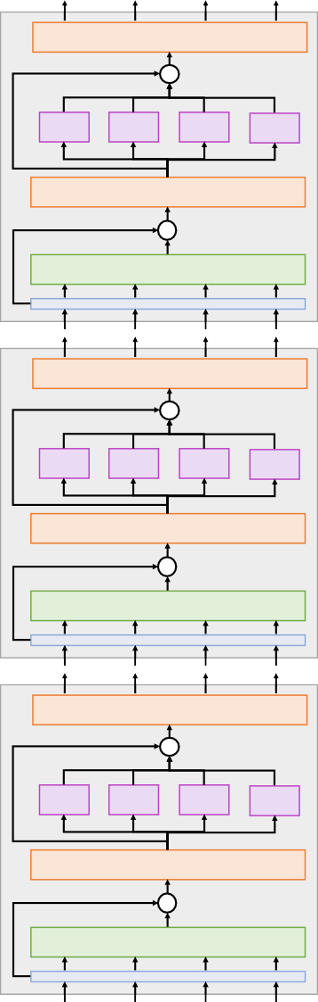
The Transformer
Layer Normalization
+
MLP MLP
MLP
MLP
Transformer Block:
Input: Set of vectors x
Output: Set of vectors y
Self-attention is the only interaction between vectors!
Layer norm and MLP work independently per vector
Highly scalable, highly
Vaswanipet aal, “arttaentliolneis allil yzouanebed”l, NeeurIPS 2017
Layer Normalization
+
Self-Attention
A Transformer is a sequence of transformer blocks
Layer Normalization
+
MLP
MLP MLP
Layer Normalization
+
Self-Attention
MLP
Vaswani et al:
12 blocks, D =512, 6 heads
Q
Layer Normalization
+
MLP MLP
MLP
MLP
Layer Normalization
+
Self-Attention

Slide 90
The Transformer: Transfer
Learning
“ImageNet Moment for Natural Language Processing”
Layer Normalization
+
MLP MLP
Layer Normalization
MLP
MLP
+
Self-Attention
Pretraining:
Download a lot of text from the internet
Layer Normalization
+
MLP
MLP MLP
Layer Normalization
+
Self-Attention
MLP
Train a giant Transformer model for language modeling
Layer Normalization
Finetuning:
Fine-tune the Transformer on your own NLP task
+
MLP MLP MLP
Layer Normalization
+
Self-Attention
MLP
Devlin et al, "BERT: Pre-training of Deep Bidirec$onal Transformers for Language Understanding", EMNLP 2018

Slide 91
Scaling up Transformers
Model | Layers | Width | Heads | Params | Data | Training
Transformer-Base | 12 | 512 | 8 | 65M |  | 8x P100 (12 hours)
Transformer-Large | 12 | 1024 | 16 | 213M |  | 8x P100 (3.5 days)
Vaswani et al, “attention is all you need”, NeurIPS 2017

Slide 92
Scaling up Transformers
Model | Layers | Width | Heads | Params | Data | Training
Transformer-Base | 12 | 512 | 8 | 65M |  | 8x P100 (12 hours)
Transformer-Large | 12 | 1024 | 16 | 213M |  | 8x P100 (3.5 days)
BERT-Base | 12 | 768 | 12 | 110M | 13 GB
BERT-Large | 24 | 1024 | 16 | 340M | 13 GB
Devlin et al, "BERT: Pre-training of Deep Bidirectional Transformers for Language Understanding", EMNLP 2018

Slide 93
Scaling up Transformers
Model | Layers | Width | Heads | Params | Data | Training
Transformer-Base | 12 | 512 | 8 | 65M |  | 8x P100 (12 hours)
Transformer-Large | 12 | 1024 | 16 | 213M |  | 8x P100 (3.5 days)
BERT-Base | 12 | 768 | 12 | 110M | 13 GB
BERT-Large | 24 | 1024 | 16 | 340M | 13 GB
XLNet-Large | 24 | 1024 | 16 | ~340M | 126 GB | 512x TPU-v3 (2.5 days)
RoBERTa | 24 | 1024 | 16 | 355M | 160 GB | 1024x V100 GPU (1 day)
Yang et al, XLNet: Generalized Autoregressive Pretraining for Language Understanding", 2019
Liu et al, "RoBERTa: A Robustly Optimized BERT Pretraining Approach", 2019

Slide 94
Scaling up Transformers
Model | Layers | Width | Heads | Params | Data | Training
Transformer-Base | 12 | 512 | 8 | 65M |  | 8x P100 (12 hours)
Transformer-Large | 12 | 1024 | 16 | 213M |  | 8x P100 (3.5 days)
BERT-Base | 12 | 768 | 12 | 110M | 13 GB
BERT-Large | 24 | 1024 | 16 | 340M | 13 GB
XLNet-Large | 24 | 1024 | 16 | ~340M | 126 GB | 512x TPU-v3 (2.5 days)
RoBERTa | 24 | 1024 | 16 | 355M | 160 GB | 1024x V100 GPU (1 day)
GPT-2 | 12 | 768 | ? | 117M | 40 GB
GPT-2 | 24 | 1024 | ? | 345M | 40 GB
GPT-2 | 36 | 1280 | ? | 762M | 40 GB
GPT-2 | 48 | 1600 | ? | 1.5B | 40 GB
Radford et al, "Language models are unsupervised multitask learners", 2019

Slide 95
Scaling up Transformers
Model | Layers | Width | Heads | Params | Data | Training
Transformer-Base | 12 | 512 | 8 | 65M |  | 8x P100 (12 hours)
Transformer-Large | 12 | 1024 | 16 | 213M |  | 8x P100 (3.5 days)
BERT-Base | 12 | 768 | 12 | 110M | 13 GB
BERT-Large | 24 | 1024 | 16 | 340M | 13 GB
XLNet-Large | 24 | 1024 | 16 | ~340M | 126 GB | 512x TPU-v3 (2.5 days)
RoBERTa | 24 | 1024 | 16 | 355M | 160 GB | 1024x V100 GPU (1 day)
GPT-2 | 12 | 768 | ? | 117M | 40 GB
GPT-2 | 24 | 1024 | ? | 345M | 40 GB
GPT-2 | 36 | 1280 | ? | 762M | 40 GB
GPT-2 | 48 | 1600 | ? | 1.5B | 40 GB
Megatron-LM | 40 | 1536 | 16 | 1.2B | 174 GB | 64x V100 GPU
Megatron-LM | 54 | 1920 | 20 | 2.5B | 174 GB | 128x V100 GPU
Megatron-LM | 64 | 2304 | 24 | 4.2B | 174 GB | 256x V100 GPU (10 days)
Megatron-LM | 72 | 3072 | 32 | 8.3B | 174 GB | 512x V100 GPU (9 days)
Shoeybi et al, "Megatron-LM: Training Multi-Billion Parameter Languge Models using Model Parallelism", 2019

Slide 96
~$430,000 on Amazon AWS!
Scaling up Transformers
Model | Layers | Width | Heads | Params | Data | Training
Transformer-Base | 12 | 512 | 8 | 65M |  | 8x P100 (12 hours)
Transformer-Large | 12 | 1024 | 16 | 213M |  | 8x P100 (3.5 days)
BERT-Base | 12 | 768 | 12 | 110M | 13 GB
BERT-Large | 24 | 1024 | 16 | 340M | 13 GB
XLNet-Large | 24 | 1024 | 16 | ~340M | 126 GB | 512x TPU-v3 (2.5 days)
RoBERTa | 24 | 1024 | 16 | 355M | 160 GB | 1024x V100 GPU (1 day)
GPT-2 | 12 | 768 | ? | 117M | 40 GB
GPT-2 | 24 | 1024 | ? | 345M | 40 GB
GPT-2 | 36 | 1280 | ? | 762M | 40 GB
GPT-2 | 48 | 1600 | ? | 1.5B | 40 GB
Megatron-LM | 40 | 1536 | 16 | 1.2B | 174 GB | 64x V100 GPU
Megatron-LM | 54 | 1920 | 20 | 2.5B | 174 GB | 128x V100 GPU
Megatron-LM | 64 | 2304 | 24 | 4.2B | 174 GB | 256x V100 GPU (10 days)
Megatron-LM | 72 | 3072 | 32 | 8.3B | 174 GB | 512x V100 GPU (9 days)
Shoeybi et al, "Megatron-LM: Training Multi-Billion Parameter Languge Models using Model Parallelism", 2019

Slide 97
PROMPT (Human-written): In a shocking finding, scientist discovered a herd of unicorns living in a remote, previously unexplored
valley, in the Andes Mountains. Even more surprising to the researchers was the fact that the unicorns spoke perfect English.
OpenAI, “Better Language Models and their Implications”, 2019, https://openai.com/blog/better-language-models/

Slide 98
PROMPT (Human-written): In a shocking finding, scientist discovered a herd of unicorns living in a remote, previously unexplored
valley, in the Andes Mountains. Even more surprising to the researchers was the fact that the unicorns spoke perfect English.
COMPLETION (Transformer-written): The scientist named the population, after their distinctive horn, Ovid’s Unicorn. These four- horned, silver-white unicorns were previously unknown to science.
Now, after almost two centuries, the mystery of what sparked this odd phenomenon is finally solved.
Dr. Jorge Pérez, an evolutionary biologist from the University of La Paz, and several companions, were exploring the Andes Mountains when they found a small valley, with no other animals or humans. Pérez noticed that the valley had what appeared to be a natural fountain, surrounded by two peaks of rock and silver snow.
Pérez and the others then ventured further into the valley. “By the time we reached the top of one peak, the water looked blue,
with some crystals on top,” said Pérez.
Pérez and his friends were astonished to see the unicorn herd. These creatures could be seen from the air without having to move too much to see them – they were so close they could touch their horns.
While examining these bizarre creatures the scientists discovered that the creatures also spoke some fairly regular English. Pérez
stated, “We can see, for example, that they have a common ‘language,’ something like a dialect or dialectic.”
Dr. Pérez believes that the unicorns may have originated in Argentina, where the animals were believed to be descendants of a lost race of people who lived there before the arrival of humans in those parts of South America.
While their origins are still unclear, some believe that perhaps the creatures were created when a human and a unicorn met each
other in a time before human civilization. According to Pérez, “In South America, such incidents seem to be quite common.” However, Pérez also pointed out that it is likely that the only way of knowing for sure if unicorns are indeed the descendants of a lost alien race is through DNA. “But they seem to be able to communicate in English quite well, which I believe is a sign of evolution, or at least a change in social organization,” said the scientist.
OpenAI, “Better Language Models and their Implications”, 2019, https://openai.com/blog/better-language-models/

Slide 99
PROMPT (Human-written): In a shocking finding, scientist discovered a herd of unicorns living in a remote, previously unexplored valley, in the Andes Mountains. Even more surprising to the researchers was the fact that the unicorns spoke perfect English.
COMPLETION (Transformer-written): The scientist named the population, after their distinctive horn, Ovid’s Unicorn. These four-
horned, silver-white unicorns were previously unknown to science.
Now, after almost two centuries, the mystery of what sparked this odd phenomenon is finally solved.
Dr. Jorge Pérez, an evolutionary biologist from the University of La Paz, and several companions, were exploring the Andes
M to
b
ountains when they found a small valley, with no other animals or humans. Pérez noticed that the valley had what appeared
e a natural fountain, surrounded by two peaks of rock and silver snow.
Pérez and the others then ventured further into the valley. “By the time we reached the top of one peak, the water looked blu e with some crystals on top,” said Pérez.
Pérez and his friends were astonished to see the unicorn herd. These creatures could be seen from the air without having to
move too much to see them – they were so close they could touch their horns.
While examining these bizarre creatures the scientists discovered that the creatures also spoke some fairly regular English. Pére tated, “We can see, for example, that they have a common ‘language,’ something like a dialect or dialectic.”
Try it yourself: https://talktotransformer.com
,
z
s
Dr. Pérez believes that the unicorns may have originated in Argentina, where the animals were believed to be descendants of a
lost race of people who lived there before the arrival of humans in those parts of South America.
While their origins are still unclear, some believe that perhaps the creatures were created when a human and a unicorn met each other in a time before human civilization. According to Pérez, “In South America, such incidents seem to be quite common.” However, Pérez also pointed out that it is likely that the only way of knowing for sure if unicorns are indeed the descendants of a lost alien race is through DNA. “But they seem to be able to communicate in English quite well, which I believe is a sign of evolution, or at least a change in social organization,” said the scientist.
OpenAI, “Better Language Models and their Implications”, 2019, https://openai.com/blog/better-language-models/

Slide 100

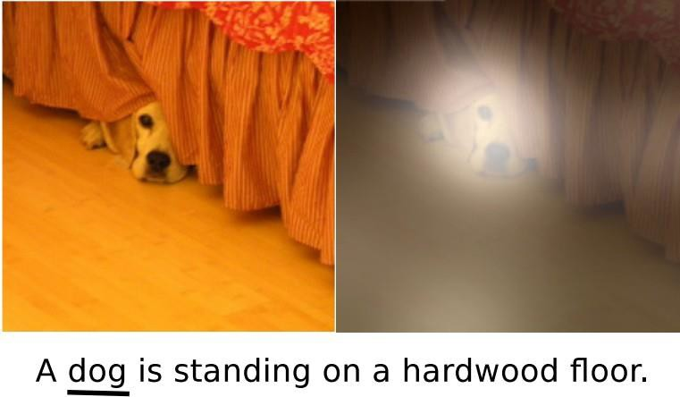

Summary
Generalized Self-Attention is new, powerful neural network primitive
Transformers are a new neural network model that only uses attention
Adding Attention to RNN models lets them look at different parts of the input at each timestep
Y₁
Y₂
Y₃
y₁
y₂
y₃
y₄
Product(→), Sum(↑)
V
Layer Normalization
3
^{A}1,3 ^{A}2,3 ^{A}
3,3
+
V₂
A1,2 ^{A}2,2
A1,1 ^{A}2,1 A3,1
A
3,2
V₁
MLP
MLP
MLP
MLP
Softmax(↑)
K₃
E1,3
E2,3
E3,3
Layer Normalization
K₂
E1,2
E2,2
E3,2
+
Self-Attention
K₁
E1,1
E2,1
E3,1
Q₁
Q₂
Q₃
X₁
X₂
X₃
x₁
x₂
x₃
x₄
Xu et al, “Show, Attend, and Tell: Neural Image Caption Generation with Visual Attention”, ICML 2015

